Slide 1
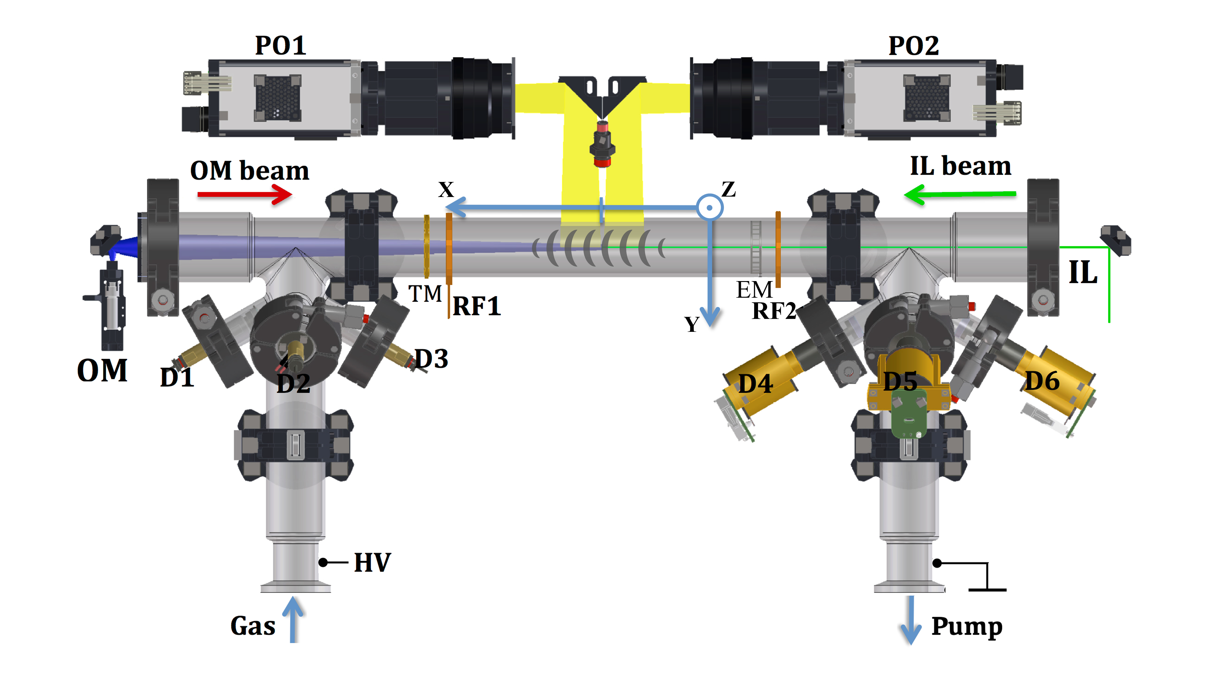
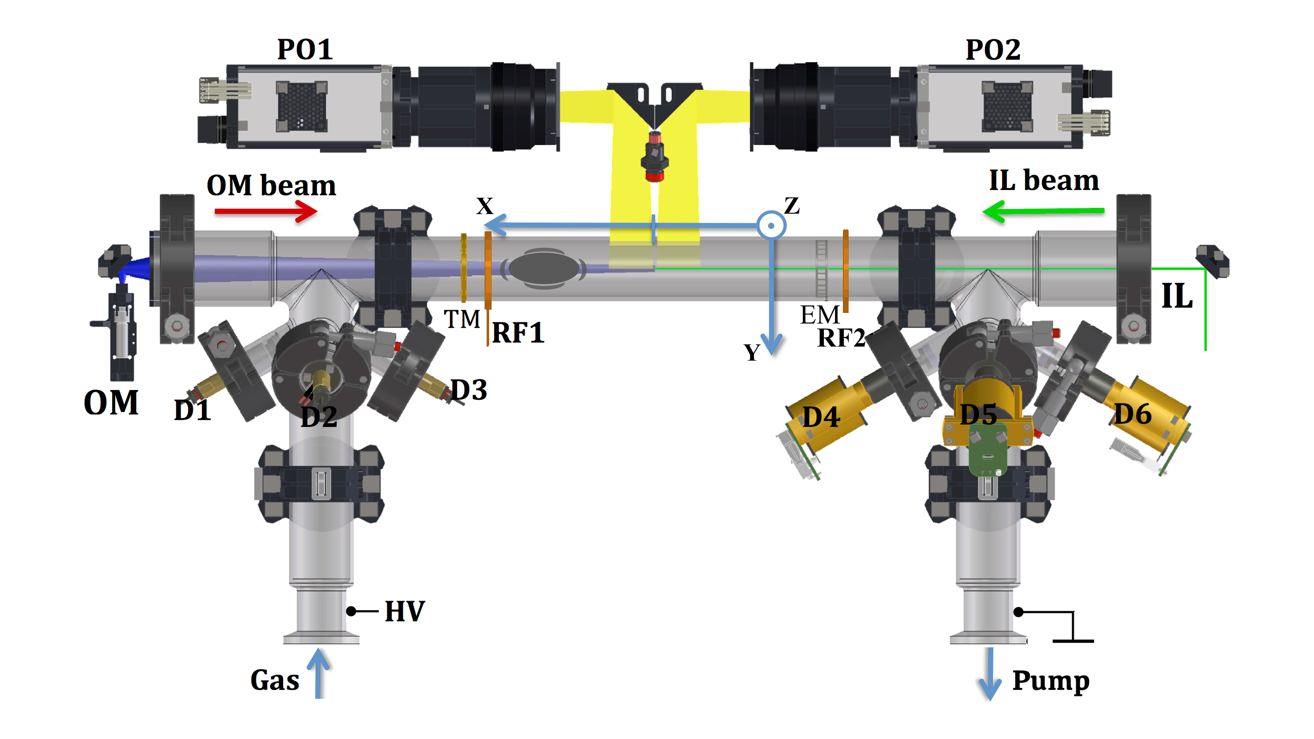

Introduction
1.
1b.
2.
2b.
Forward (F)
Backward (B)
I = - 0.5 mA
I = 0.5 mA

Slide 2
Introduction
V_group
Forward (F)
Backward (B)
I = - 0.5 mA
I = 0.5 mA

Slide 3
Introduction
C_daw = v_group – v_phase_measured
V_group
Forward (F)
Backward (B)
I = - 0.5 mA
I = 0.5 mA

Slide 4
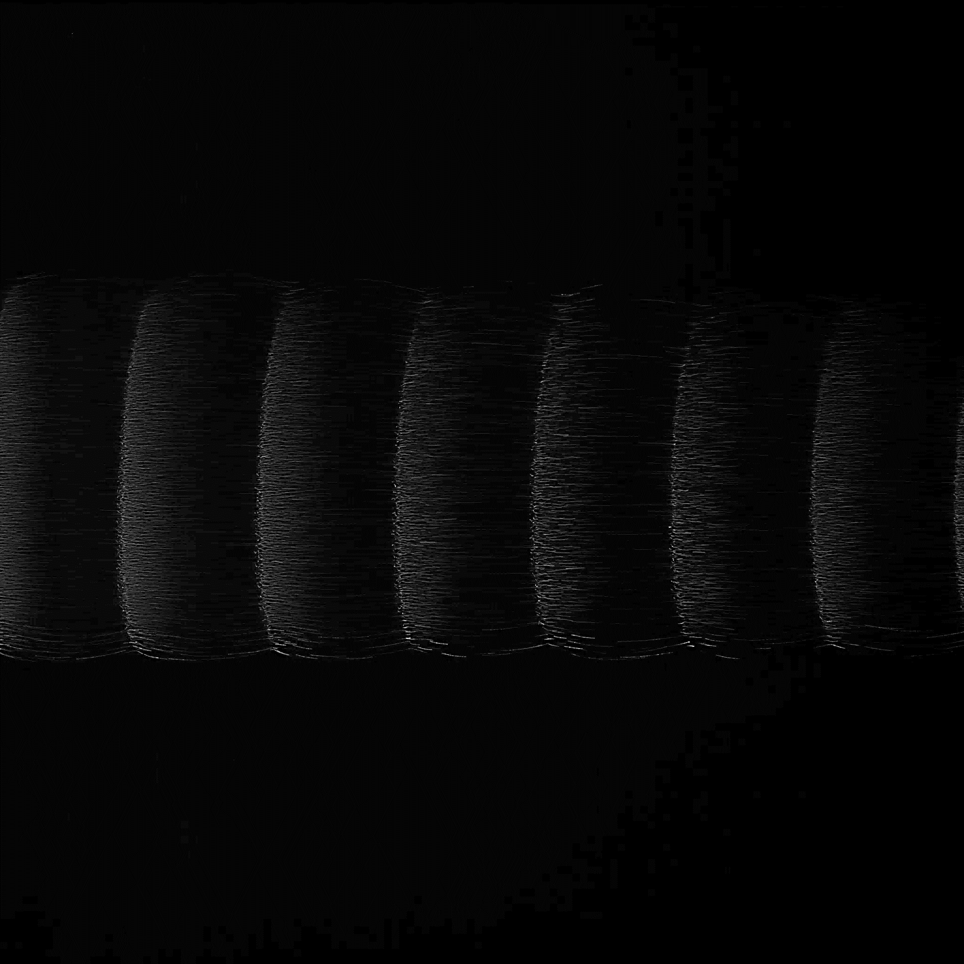
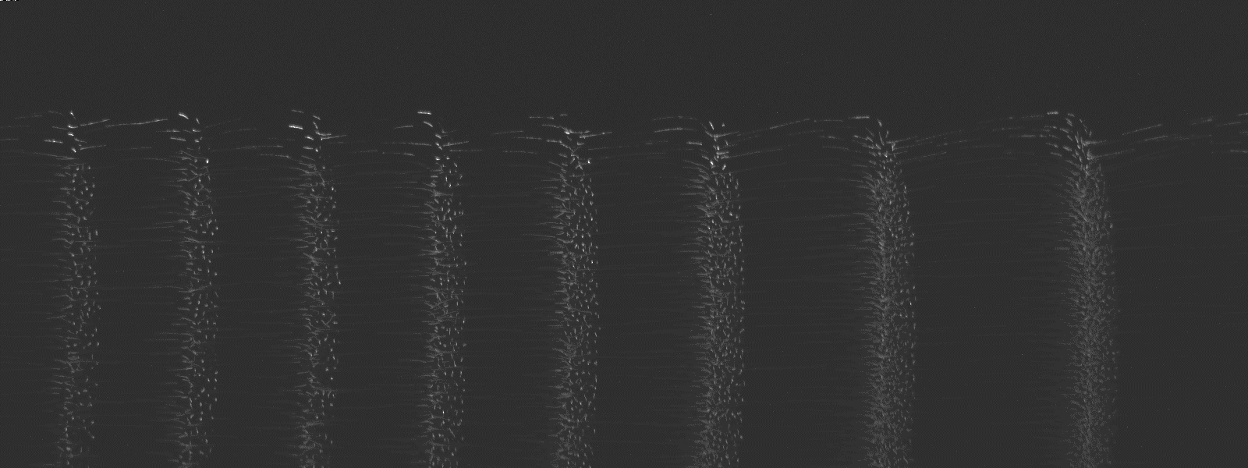
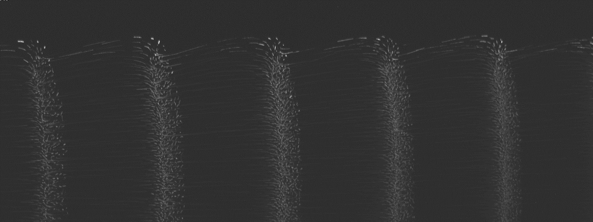
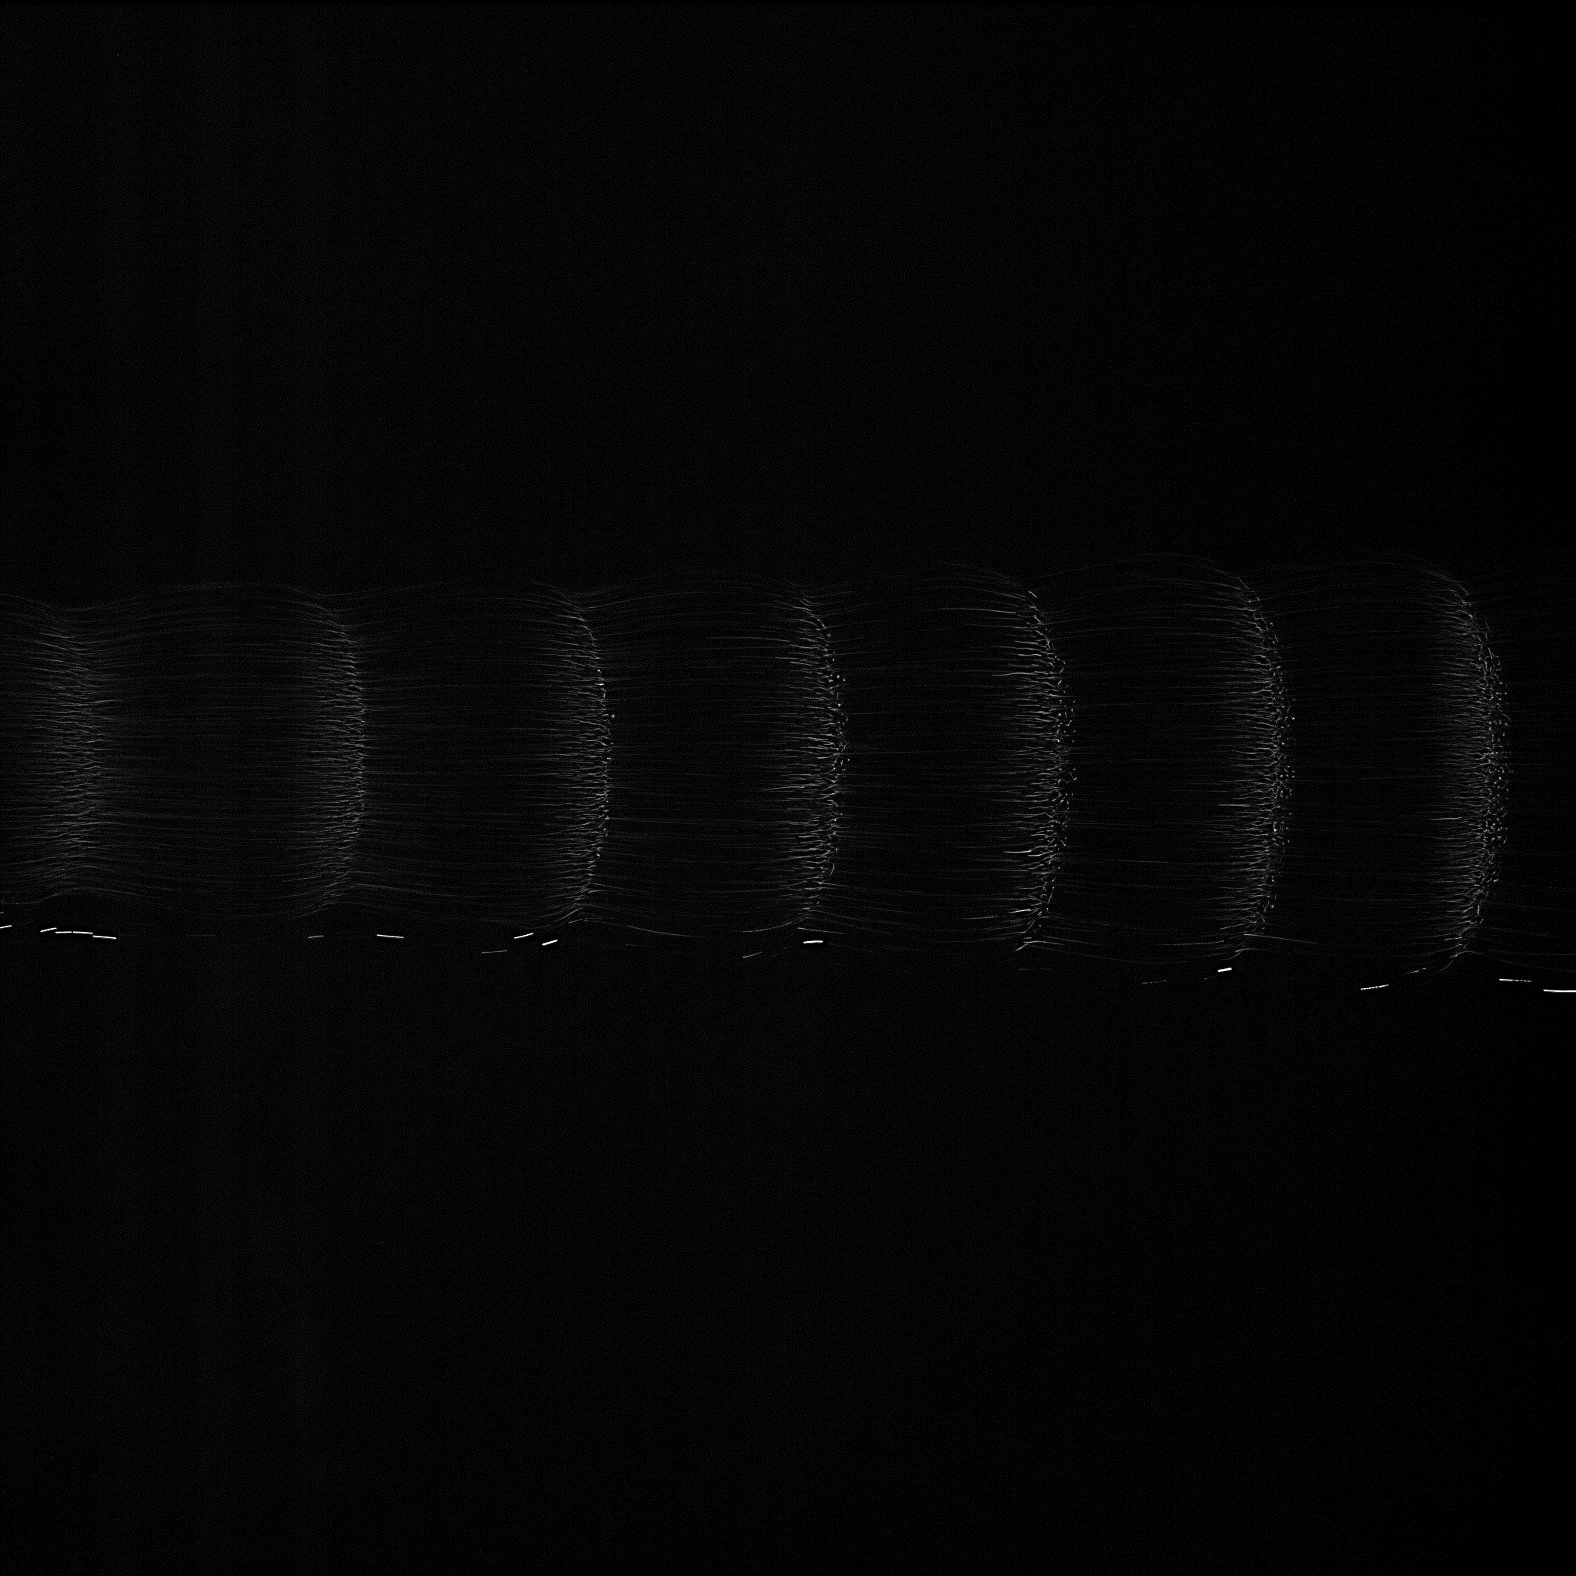
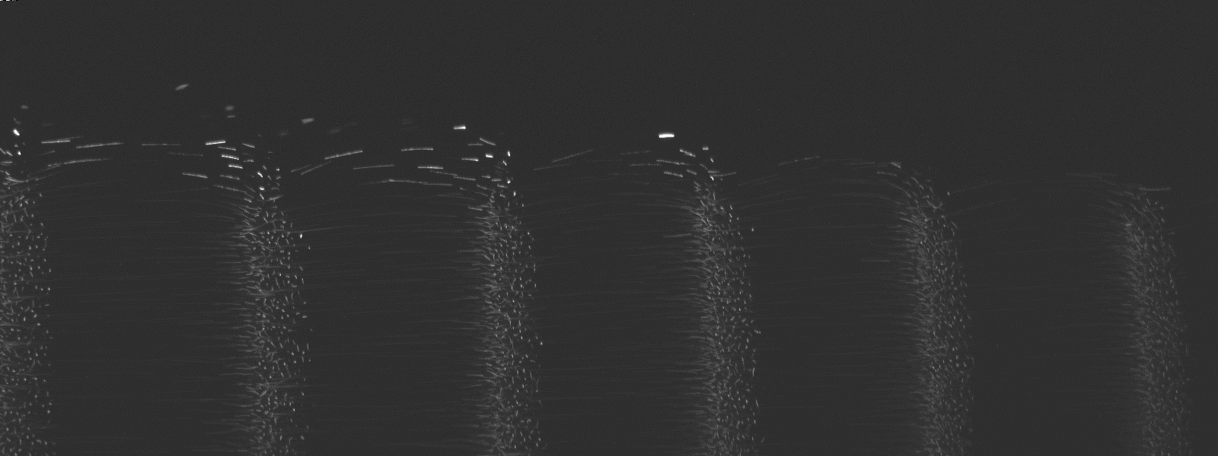

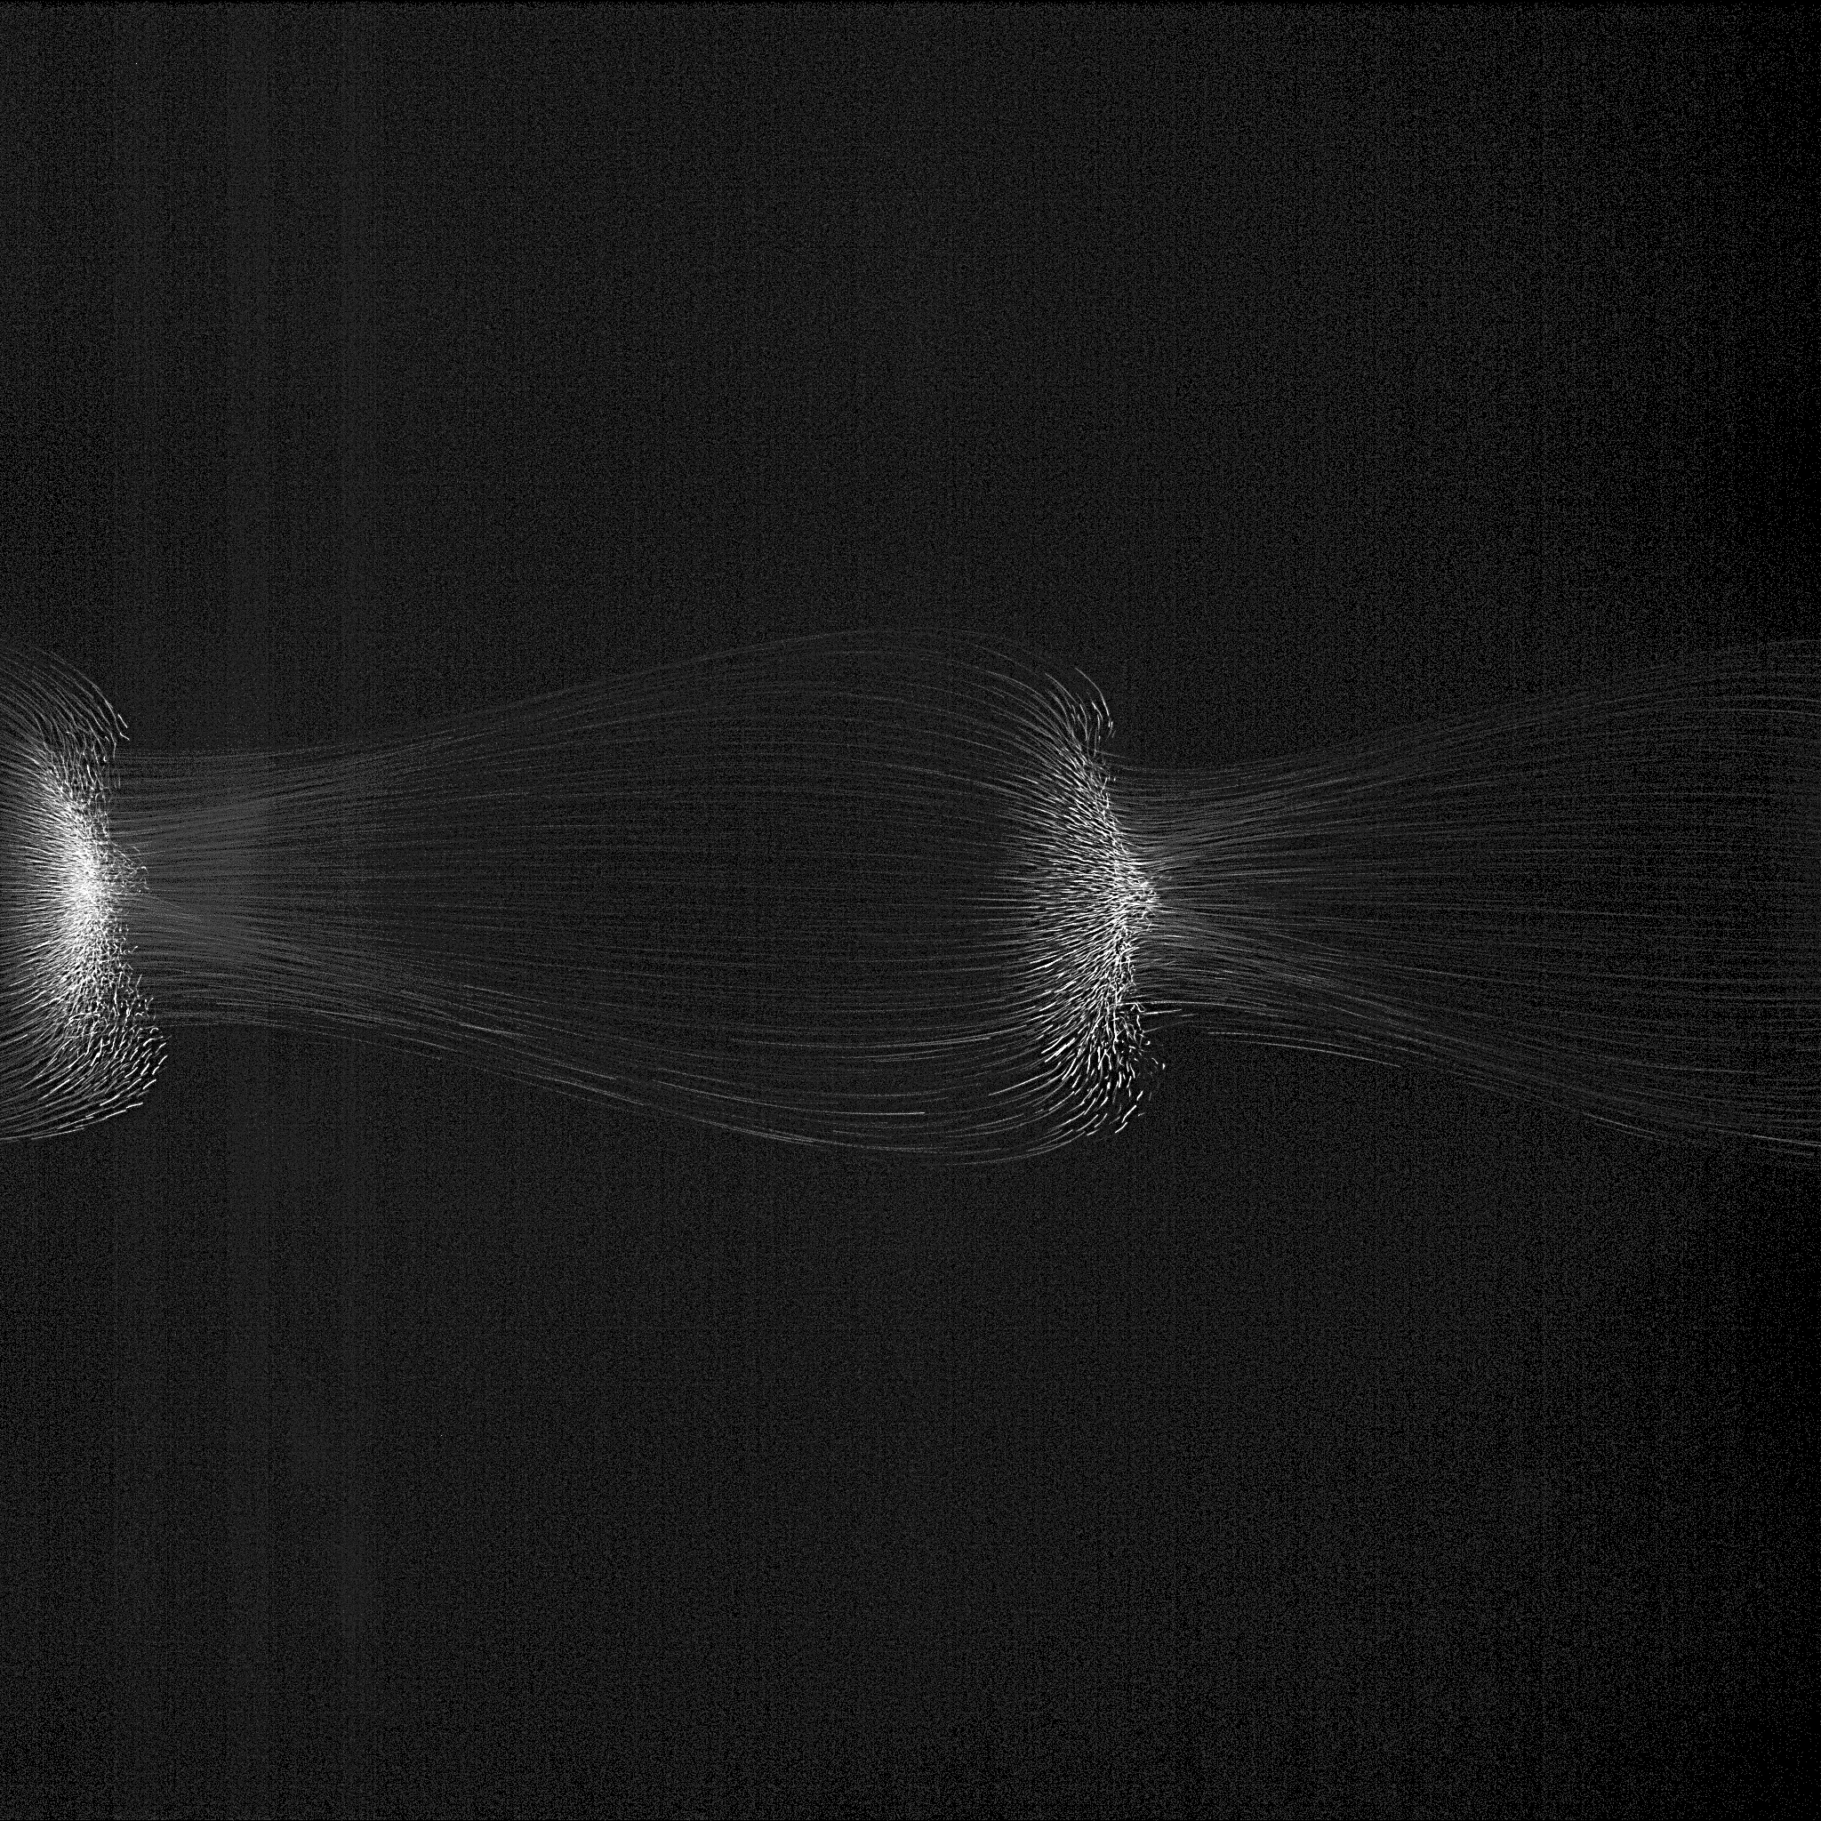
2 mm
PFC
40 Pa
2 mm
ISS
30 Pa
25 Pa
20 Pa
15 Pa

Slide 5
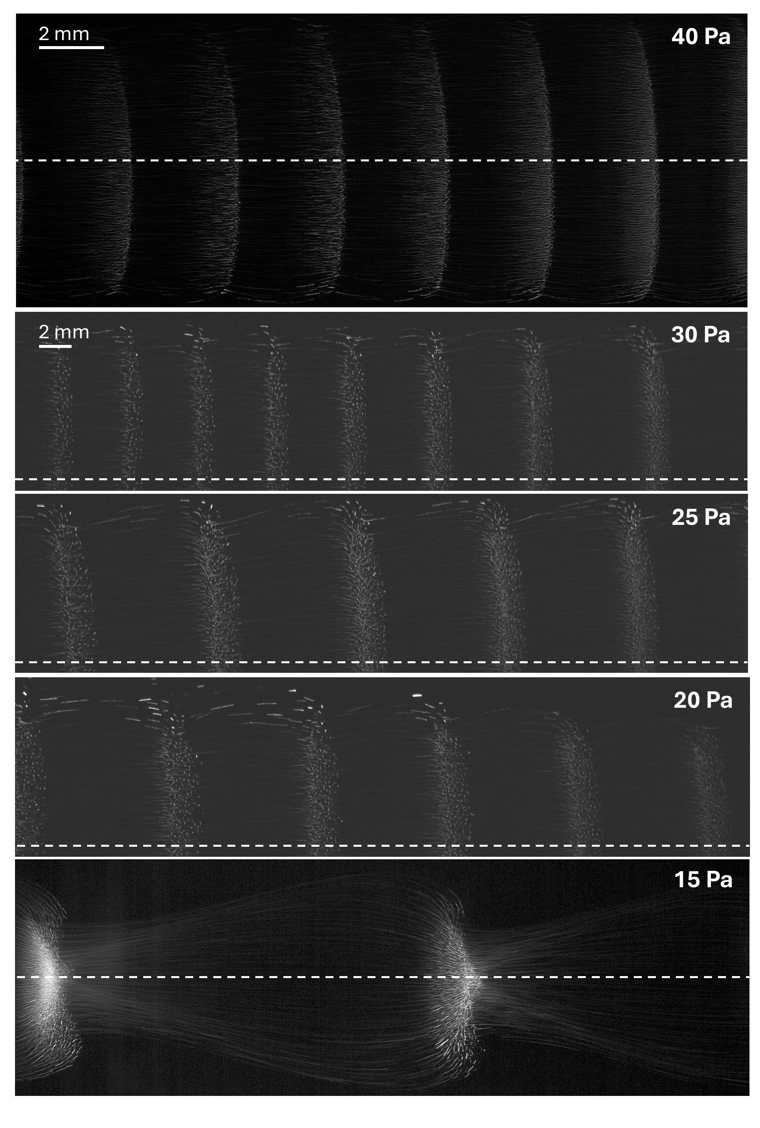
PFC
ISS

Slide 6
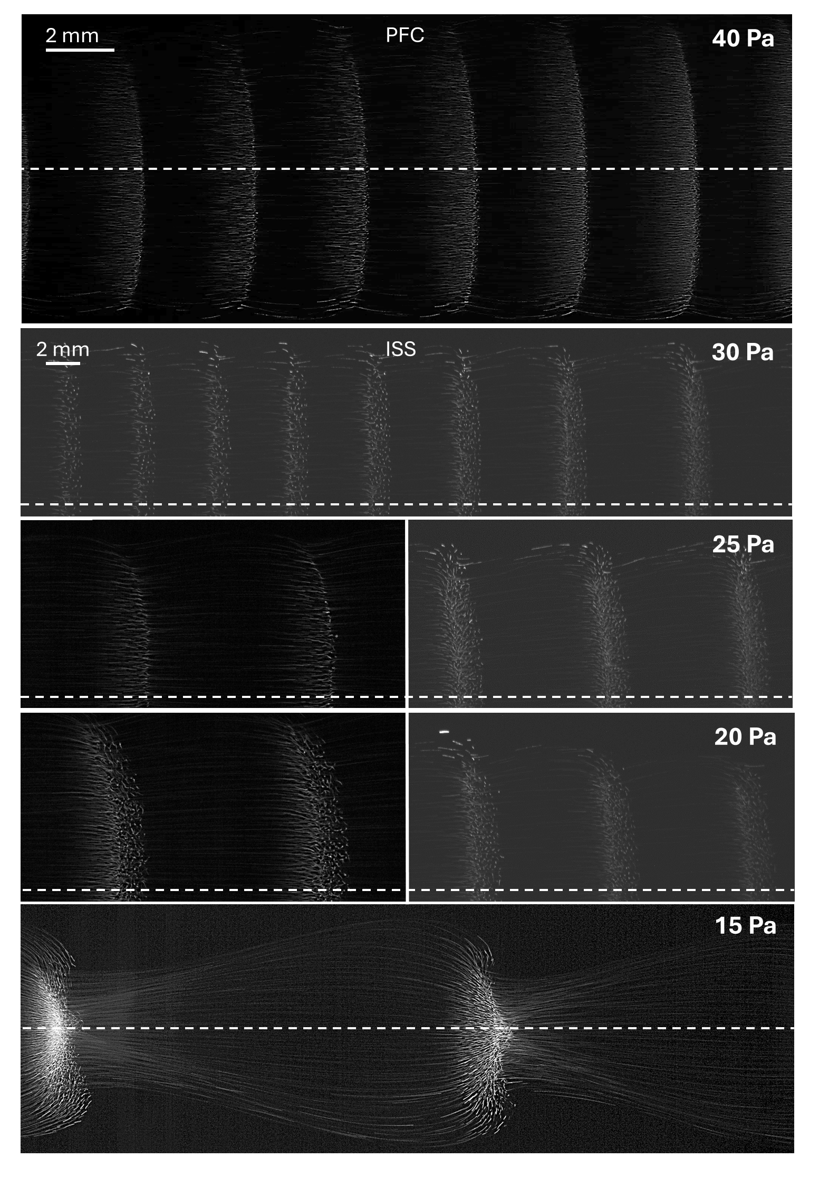

Slide 7
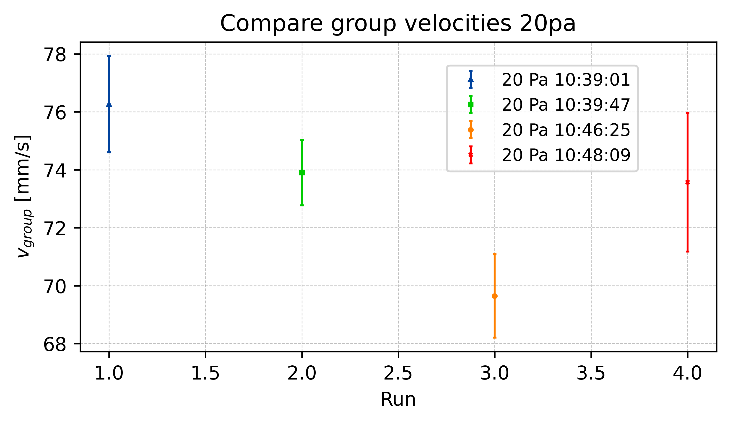
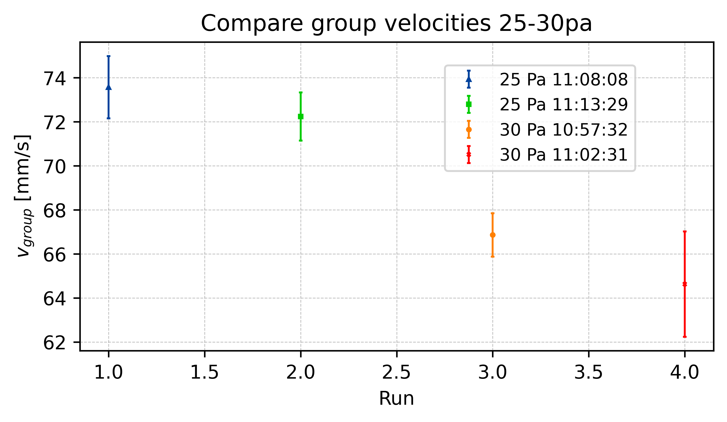
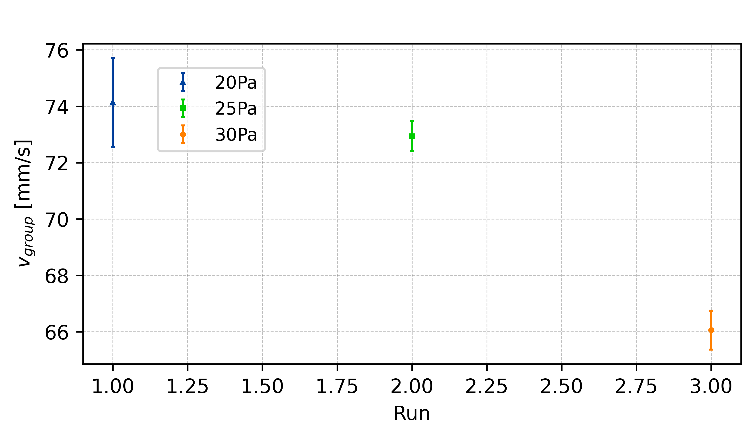
Group Velocity

Slide 8
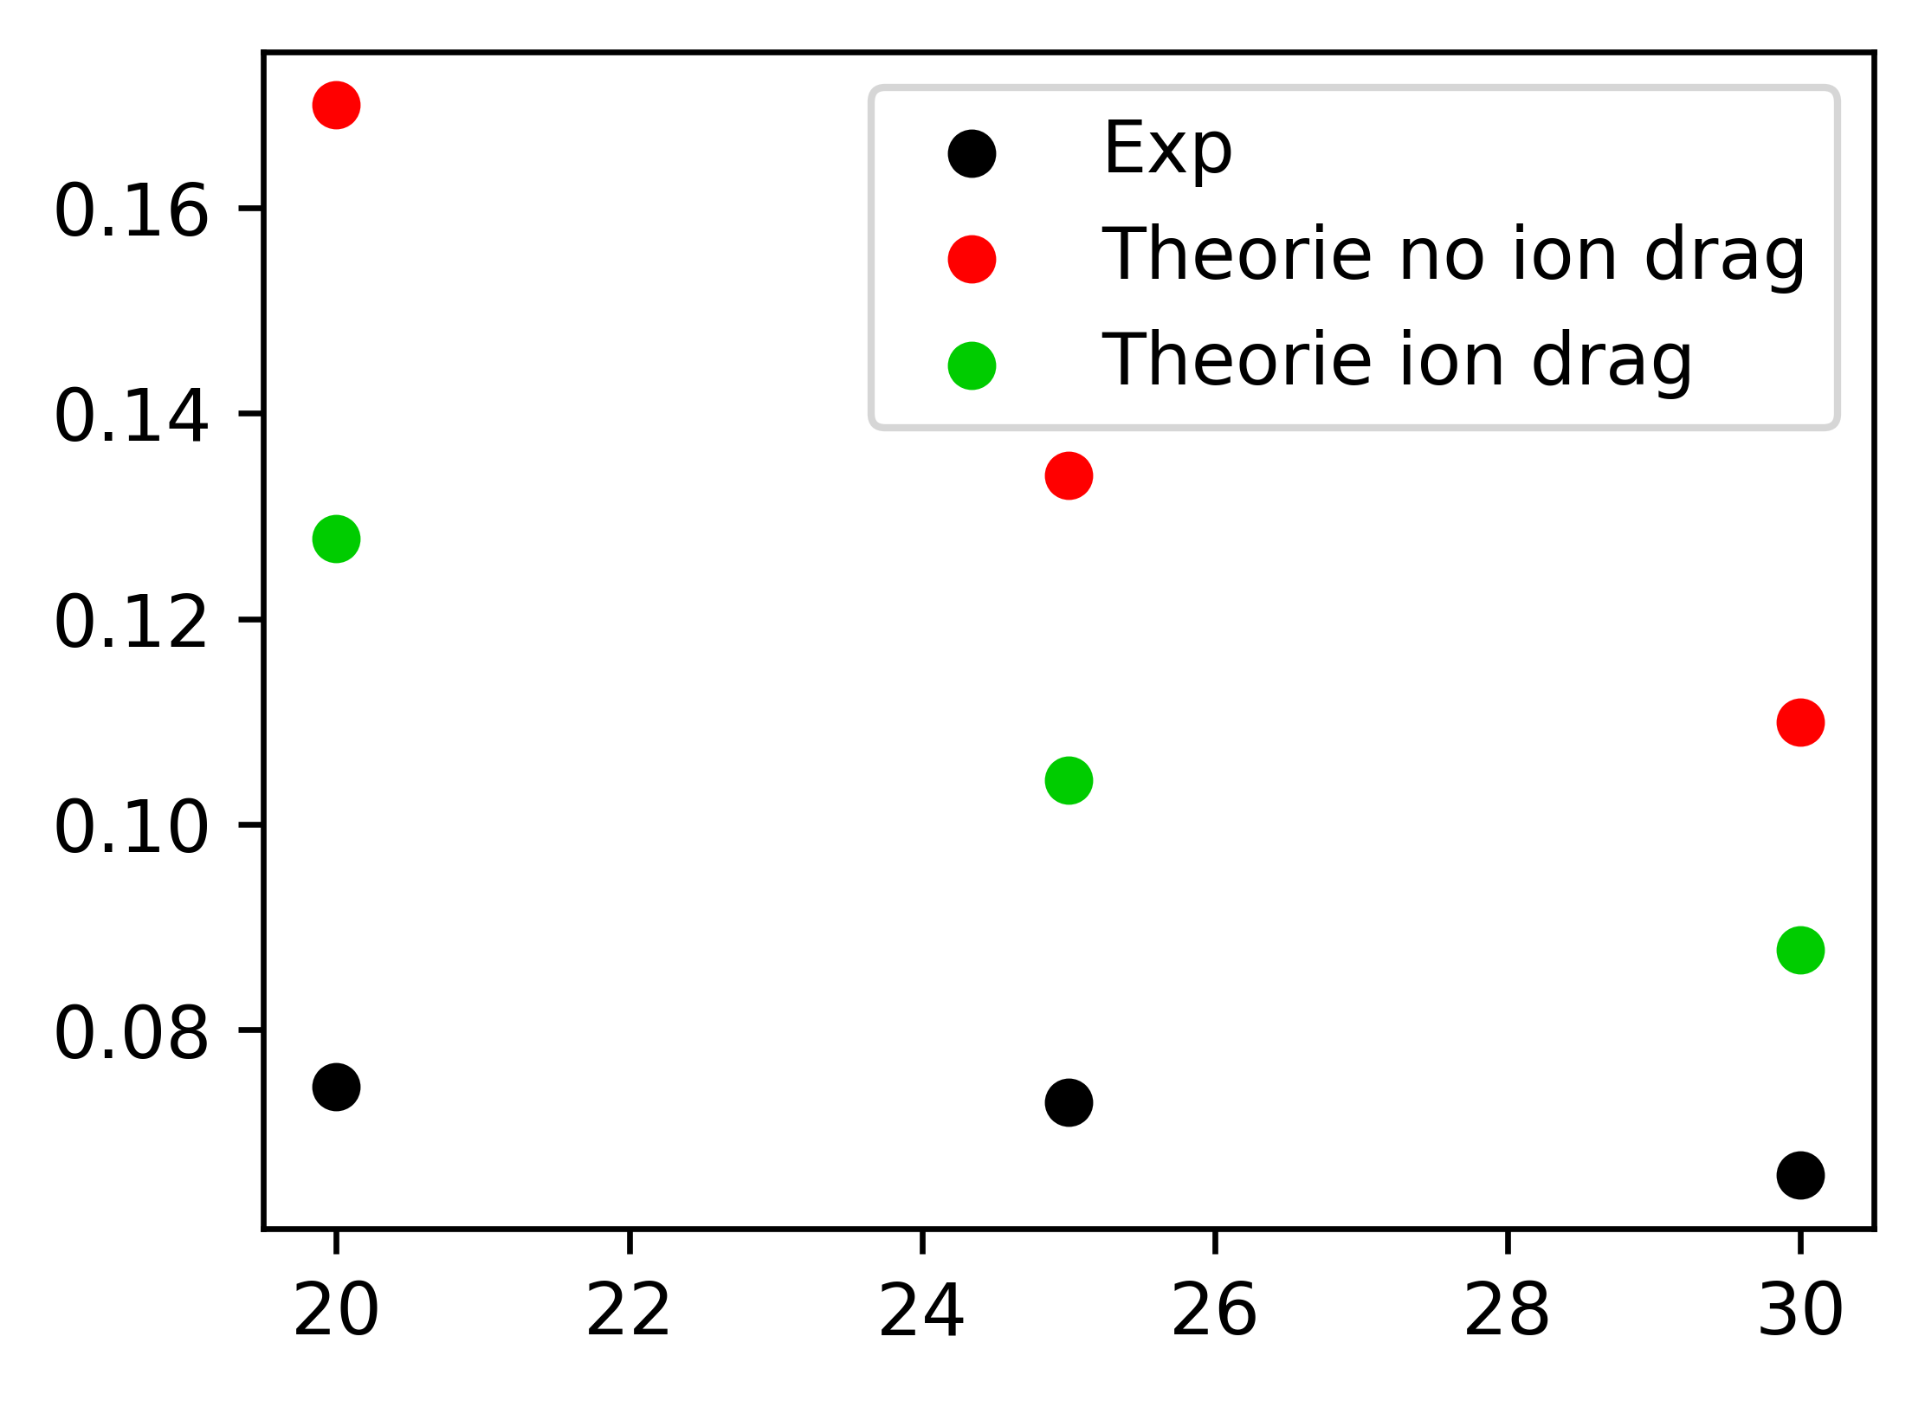
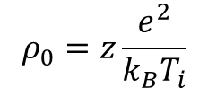
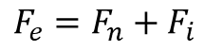
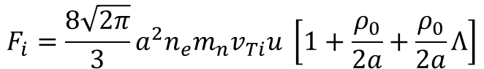
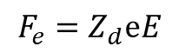
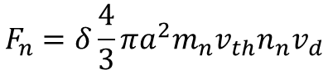
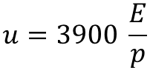
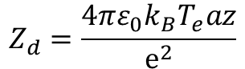
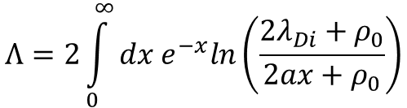
Theoretical Group Velocity
Khrapak et. al.
$$F_{e}=F_{n}+F_{i}$$
$$F_{e}=Z_{d}ⅇE$$
Z=0.345
$$F_{n}=δ\frac{4}{3}πa^{2}m_{n}v_{th}n_{n}v_{d}$$
$$F_{i}=\frac{8\sqrt{2π}}{3}a^{2}n_{e}m_{n}v_{Ti}u \left[1+\frac{ρ_{0}}{2a}+\frac{ρ_{0}}{2a}Λ\right]$$
$$ρ_{0}=z\frac{e^{2}}{k_{B}T_{i}}$$
$$Λ=2\int_{0}^{∞}{dx e^{−x}ln\left(\frac{2λ_{Di}+ρ_{0}}{2ax+ρ_{0}}\right)}$$
$$u=3900 \frac{E}{p}$$
$$Z_{d}=\frac{4πε_{0}k_{B}T_{e}az}{ⅇ^{2}}$$

Slide 9
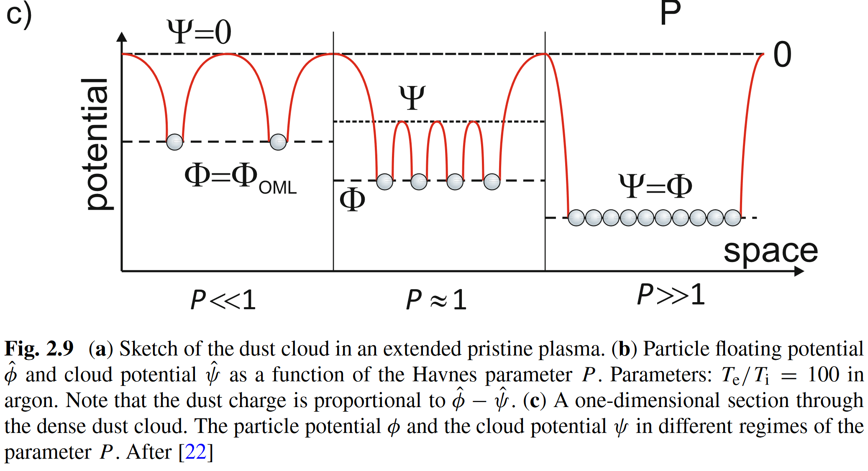
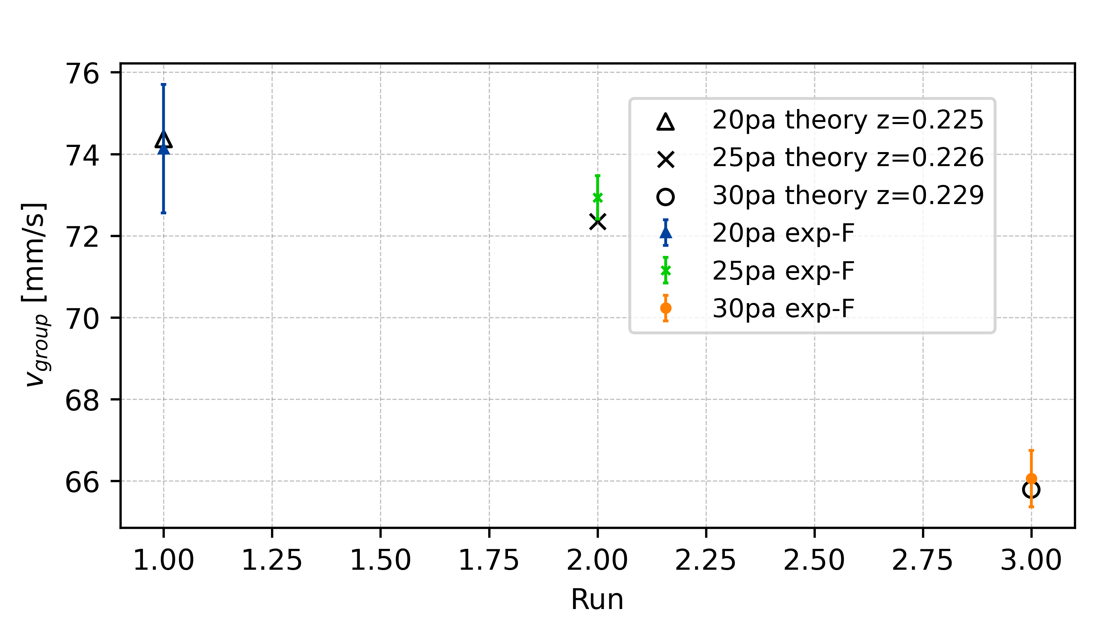
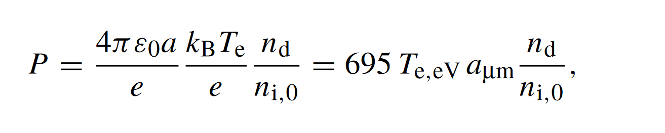
Charge Depletion – Havnes Parameter
[20Pa, 25Pa, 30Pa]
[2.047, 1.967, 1.899, 1.838]
New z from depletion theory

Slide 10
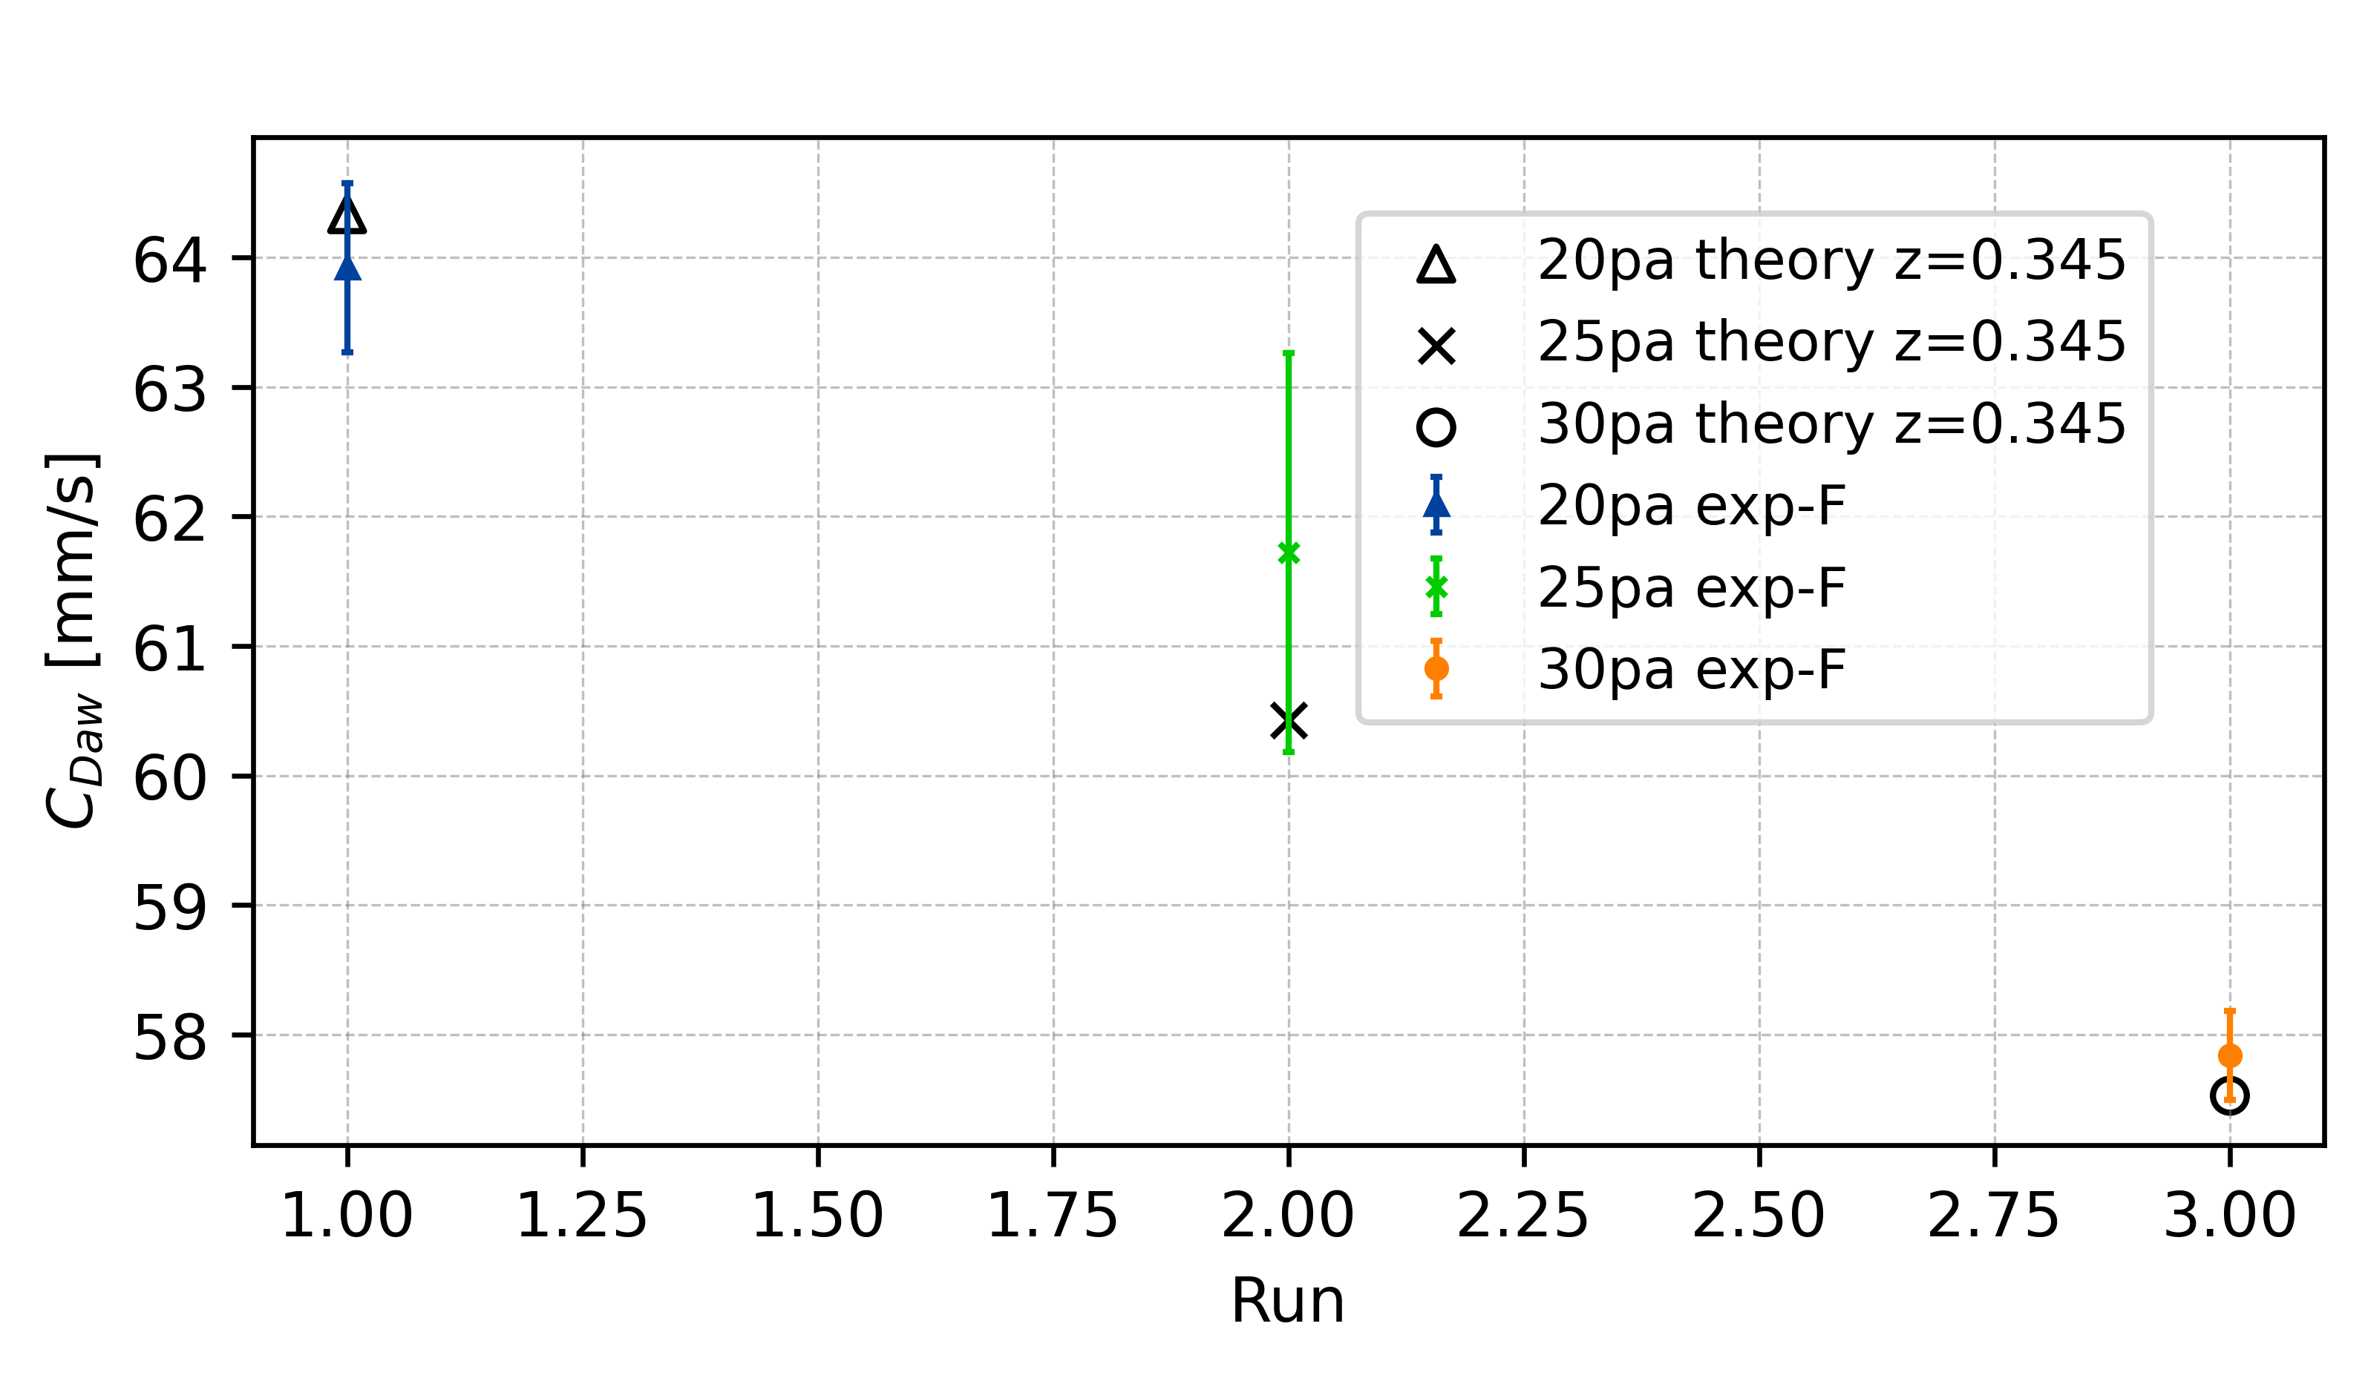
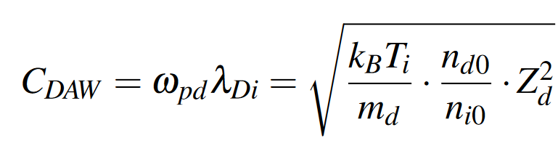
Dust-accoustic wave phase speed – C_{DAW}
Charge depletion is not playing a role in wave propagation
Charge reduction of individual particle is trigger effect of collective wave phenomena

Slide 11
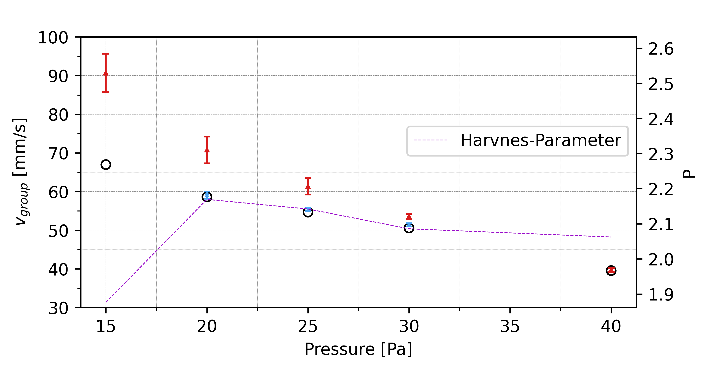
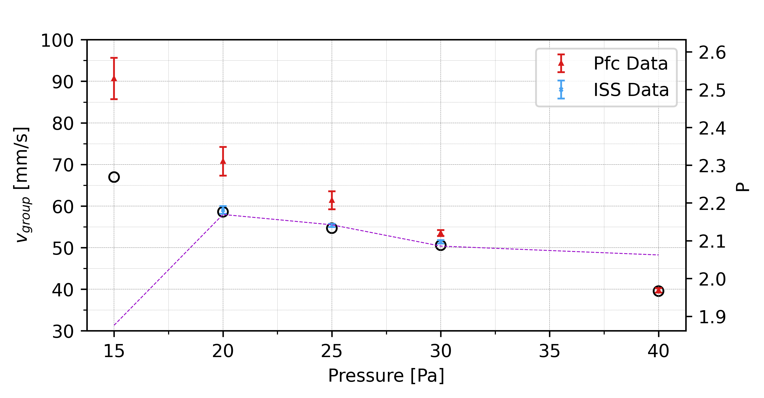
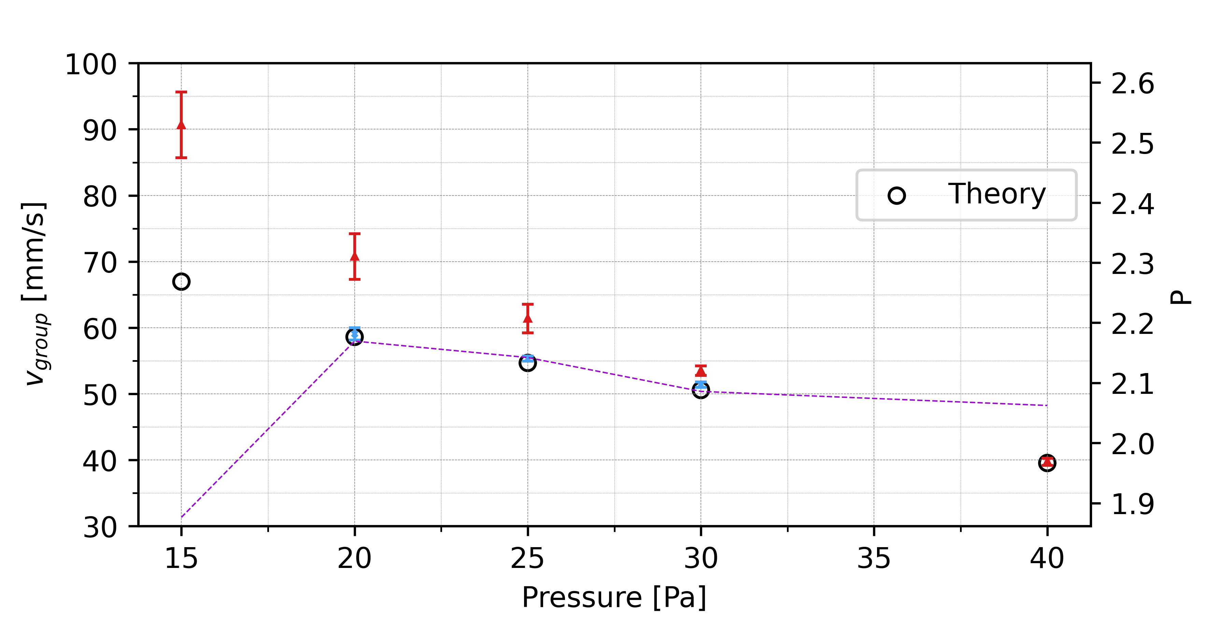

Slide 12
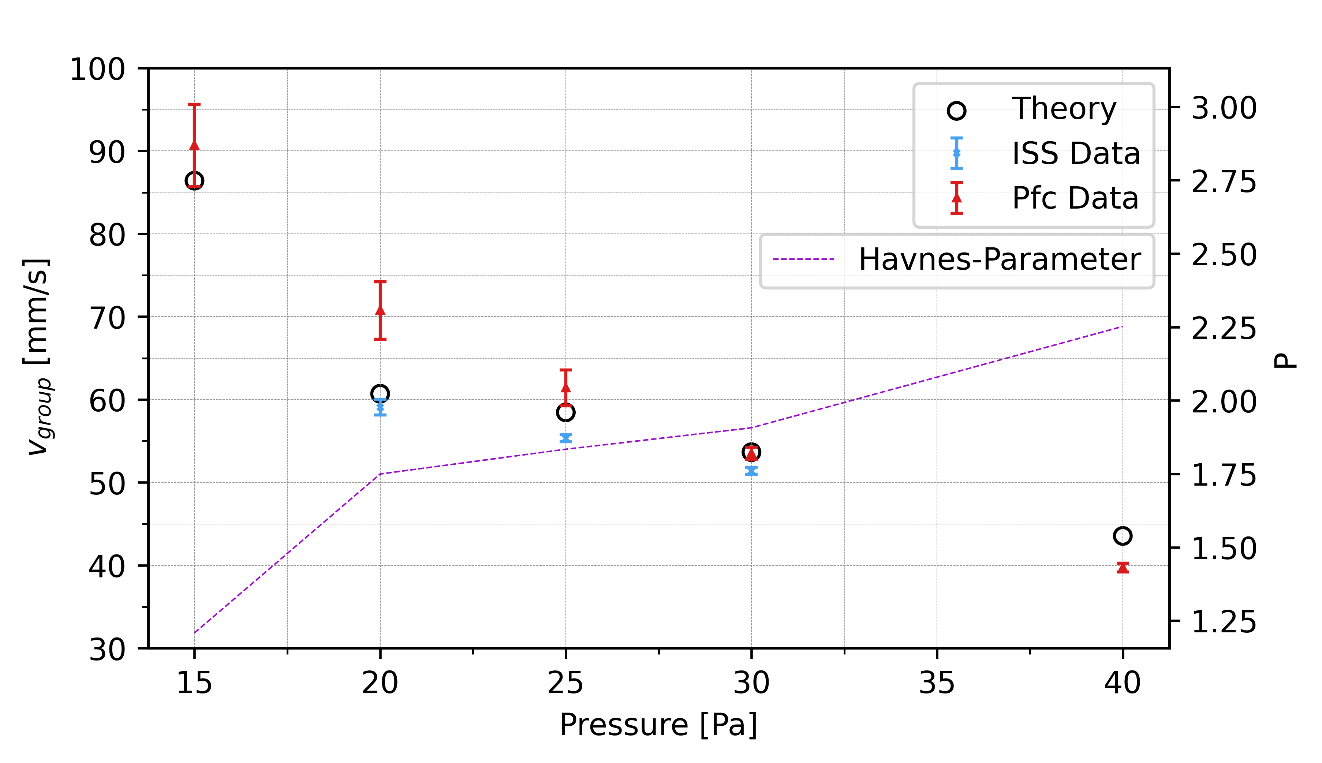
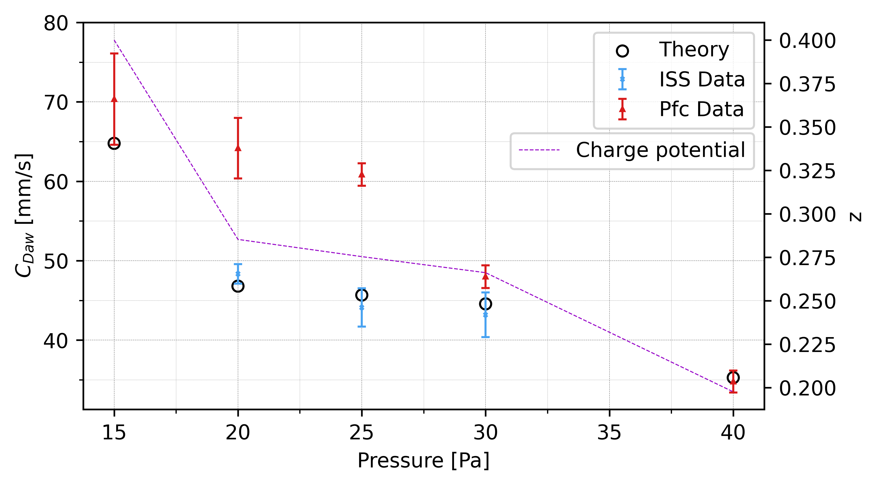

Slide 13
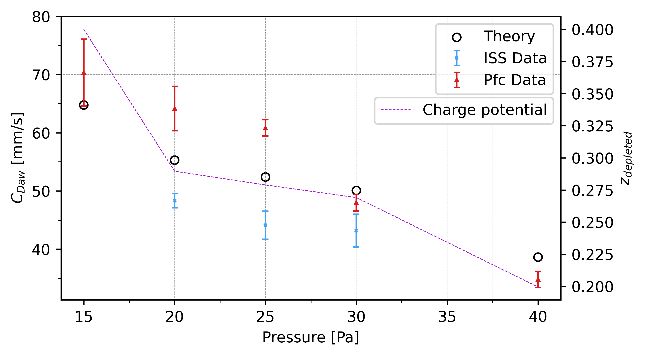

Slide 14
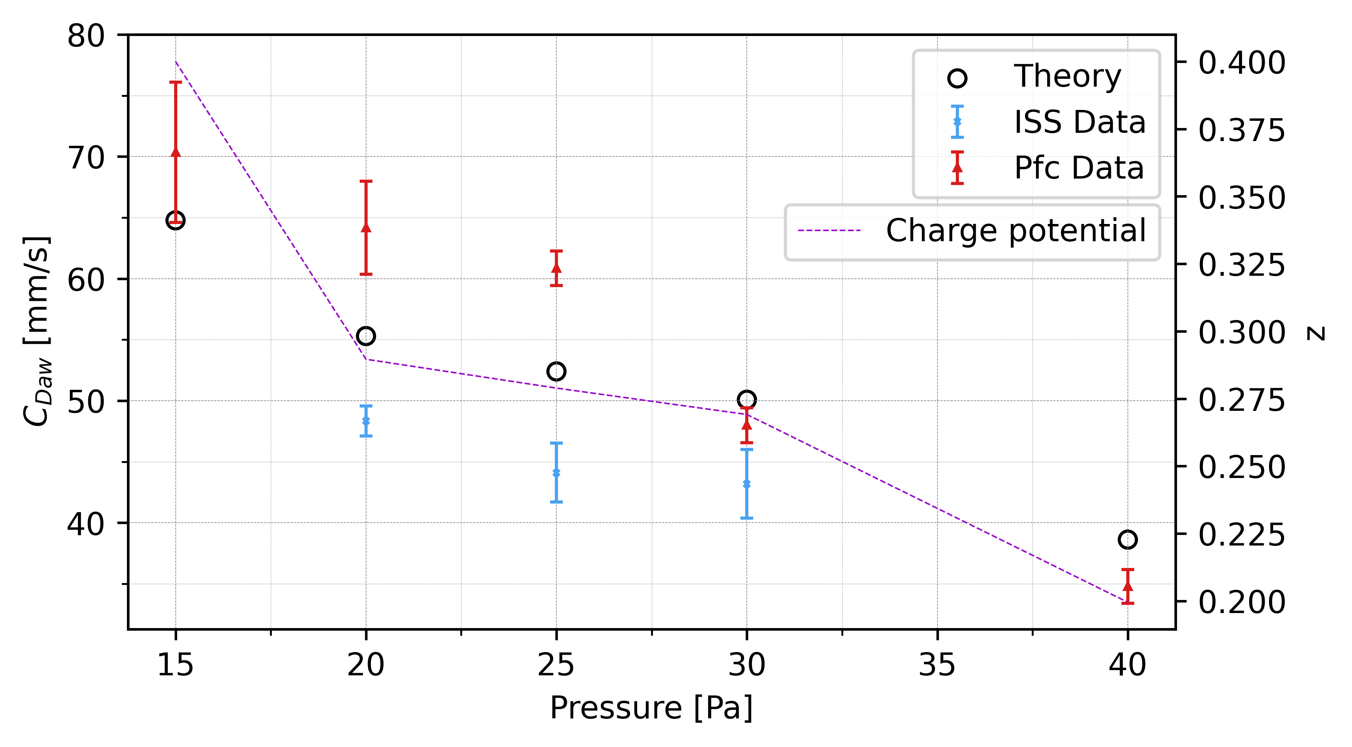
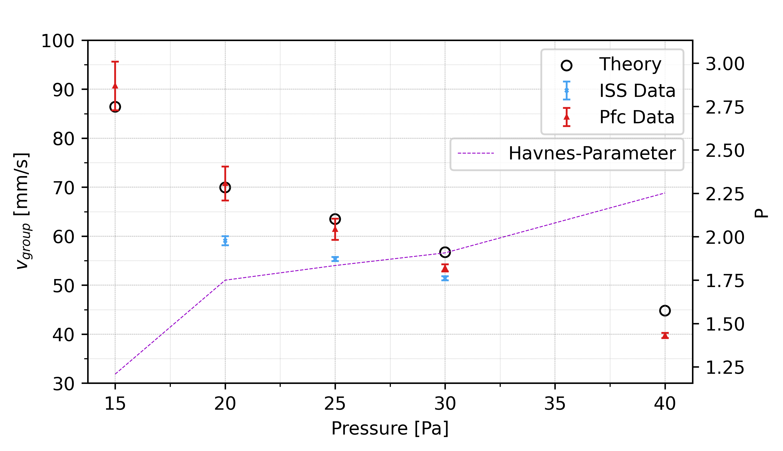

Slide 15
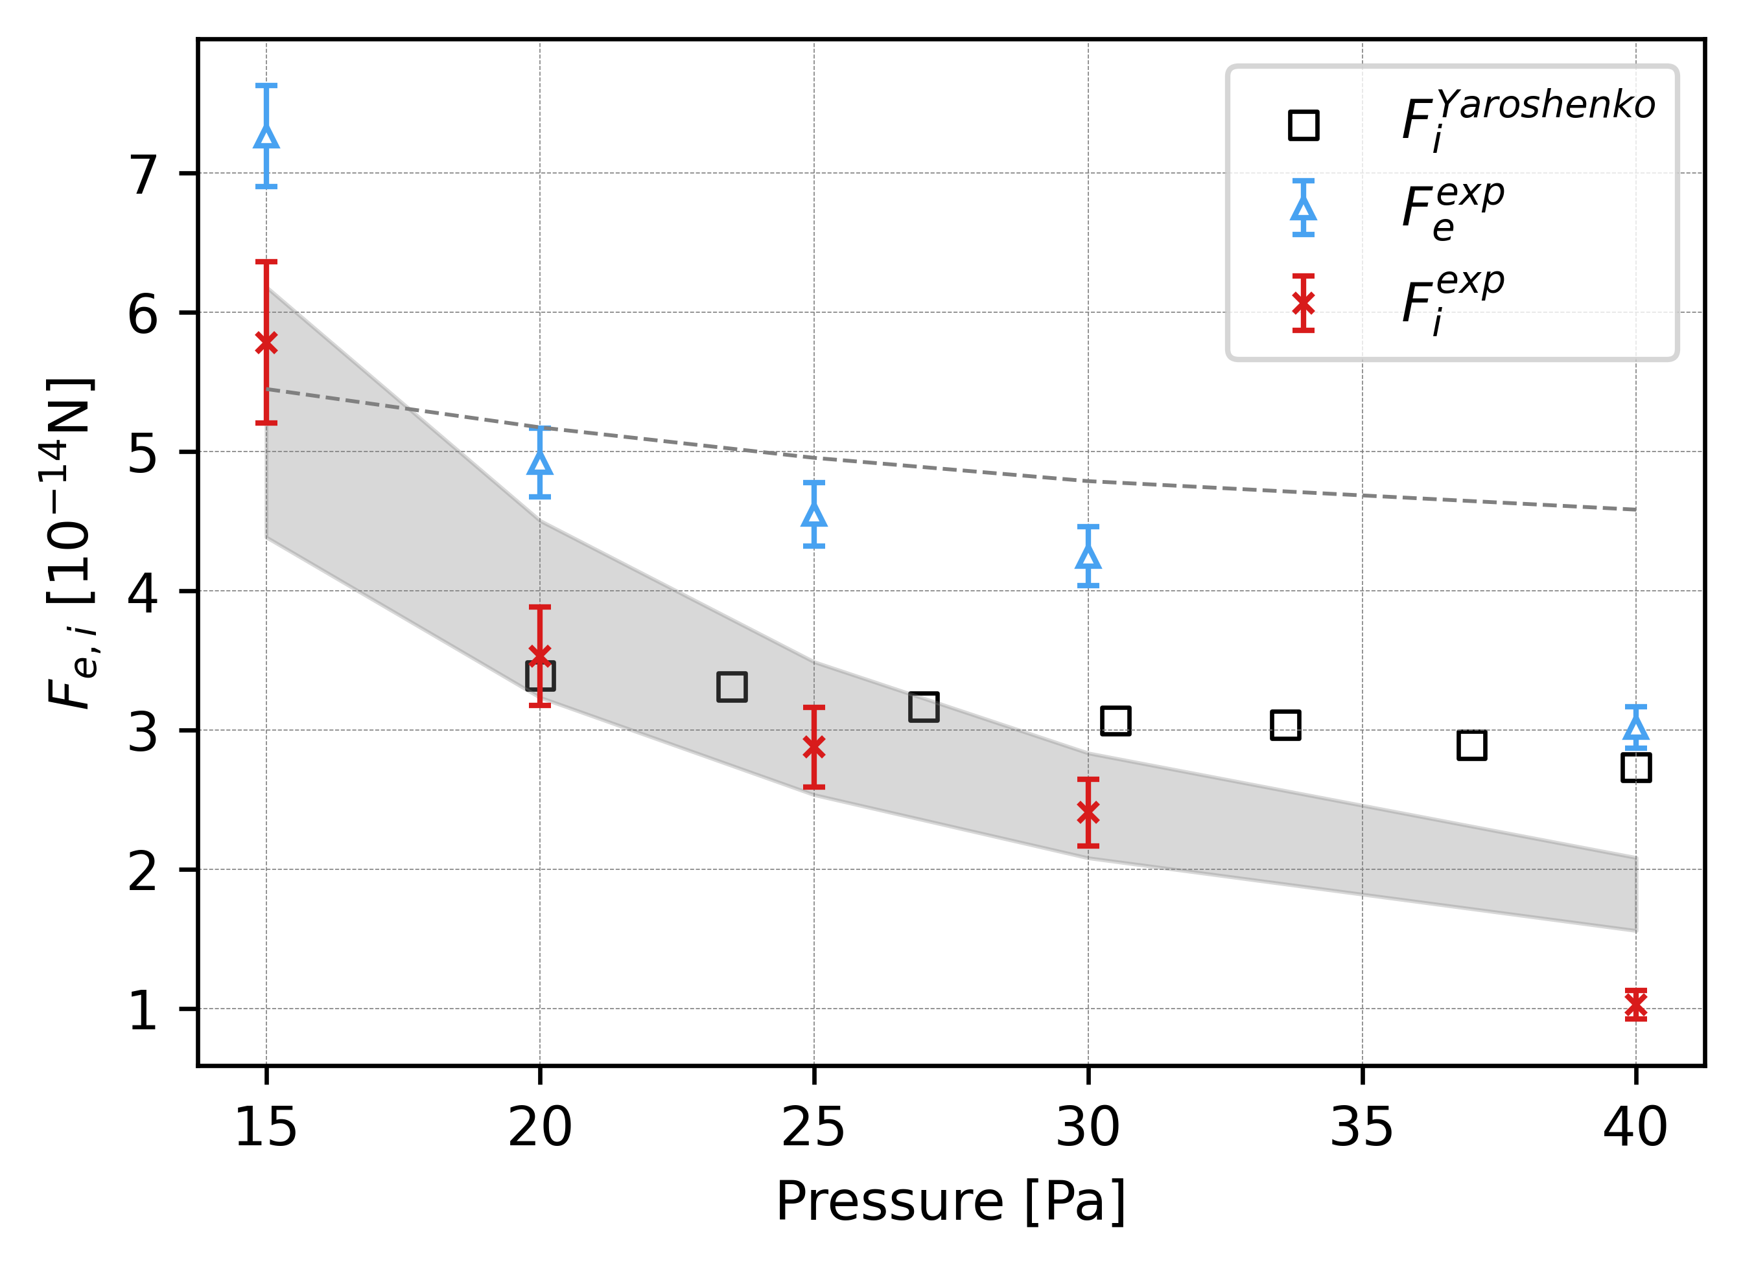
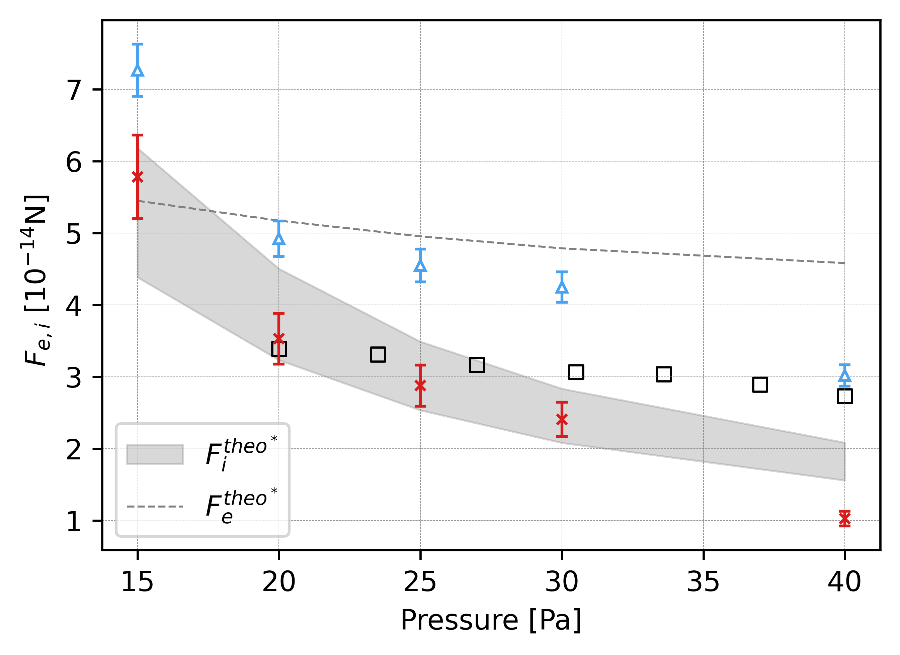

Slide 16
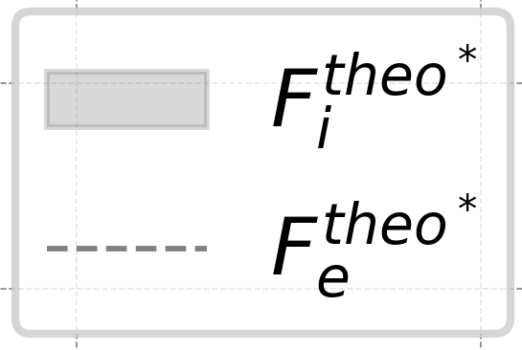

Slide 17
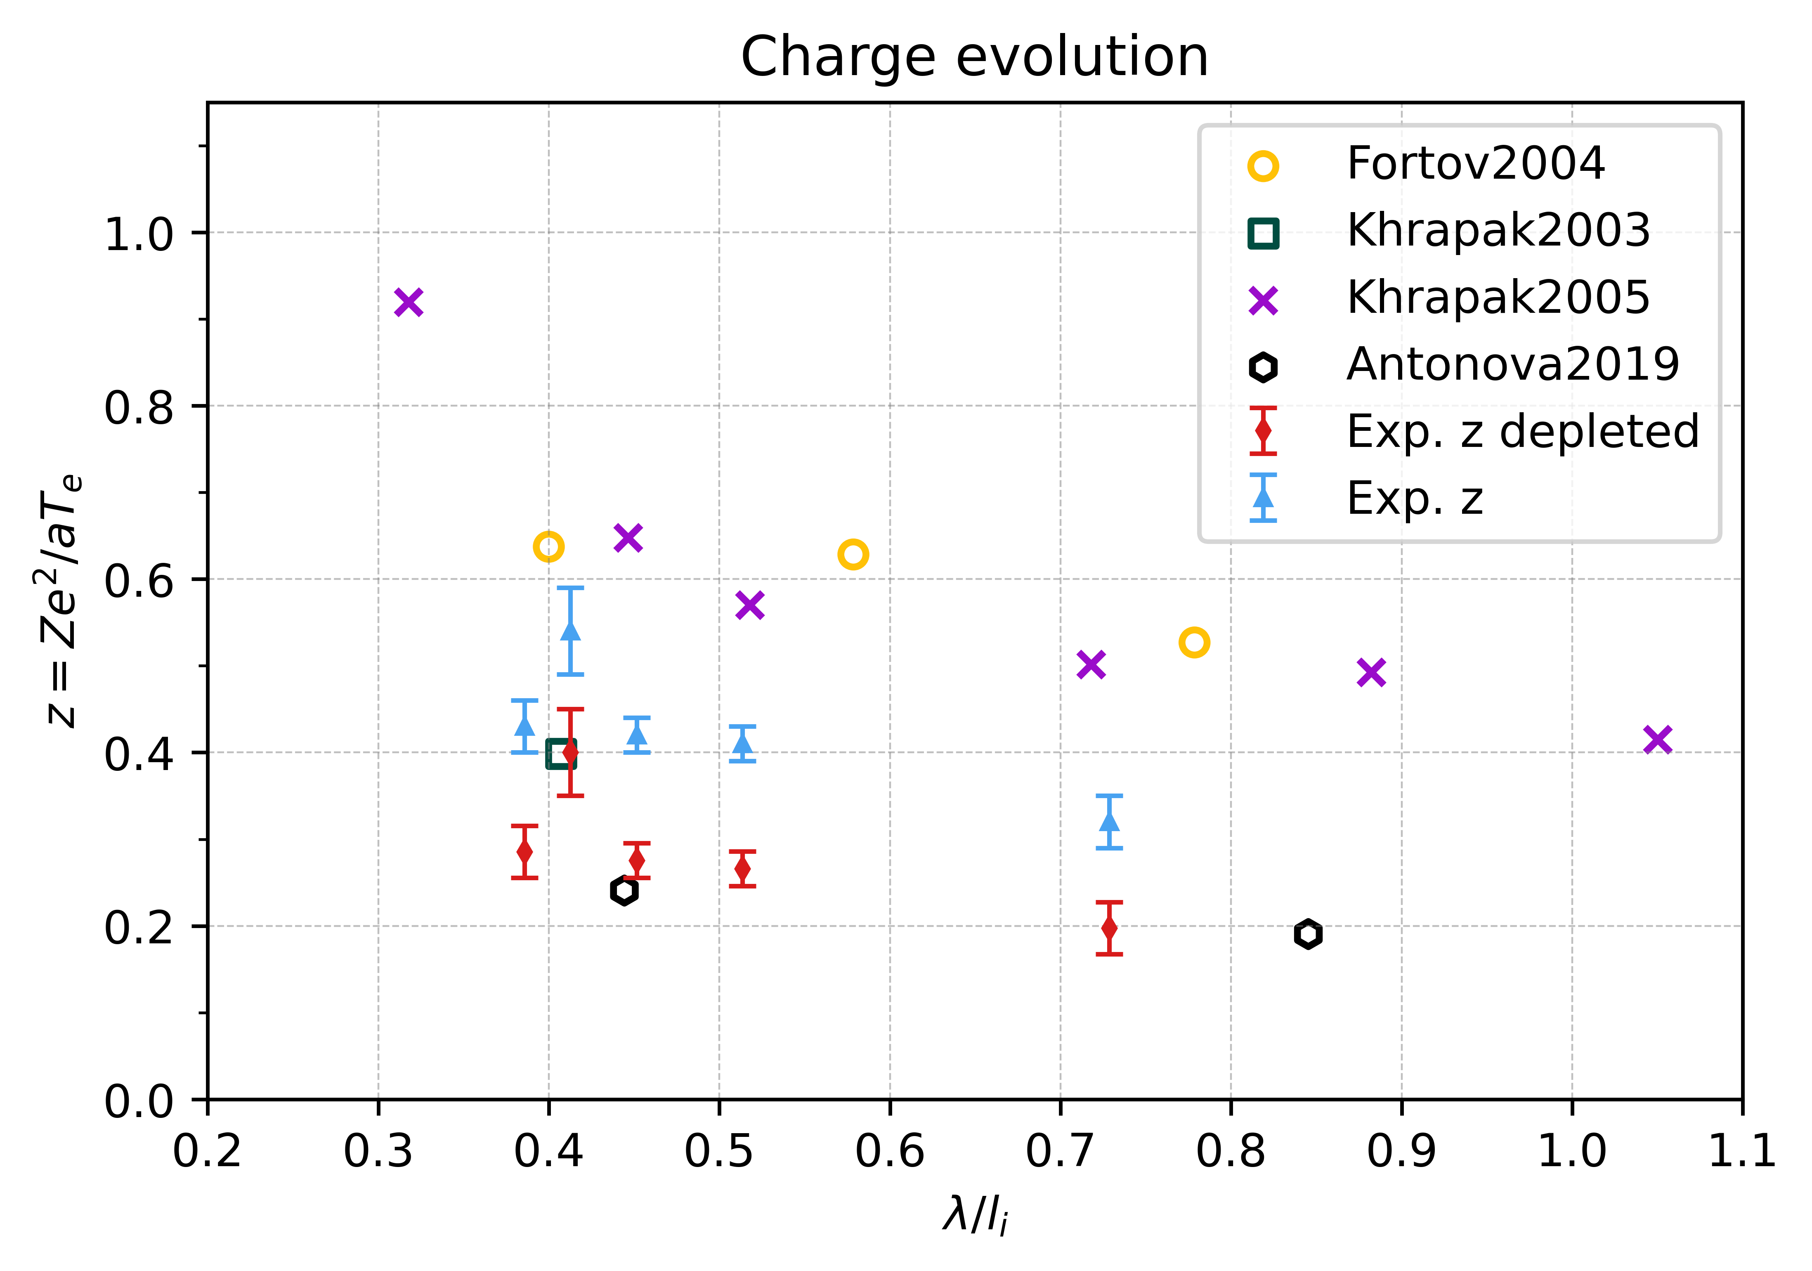
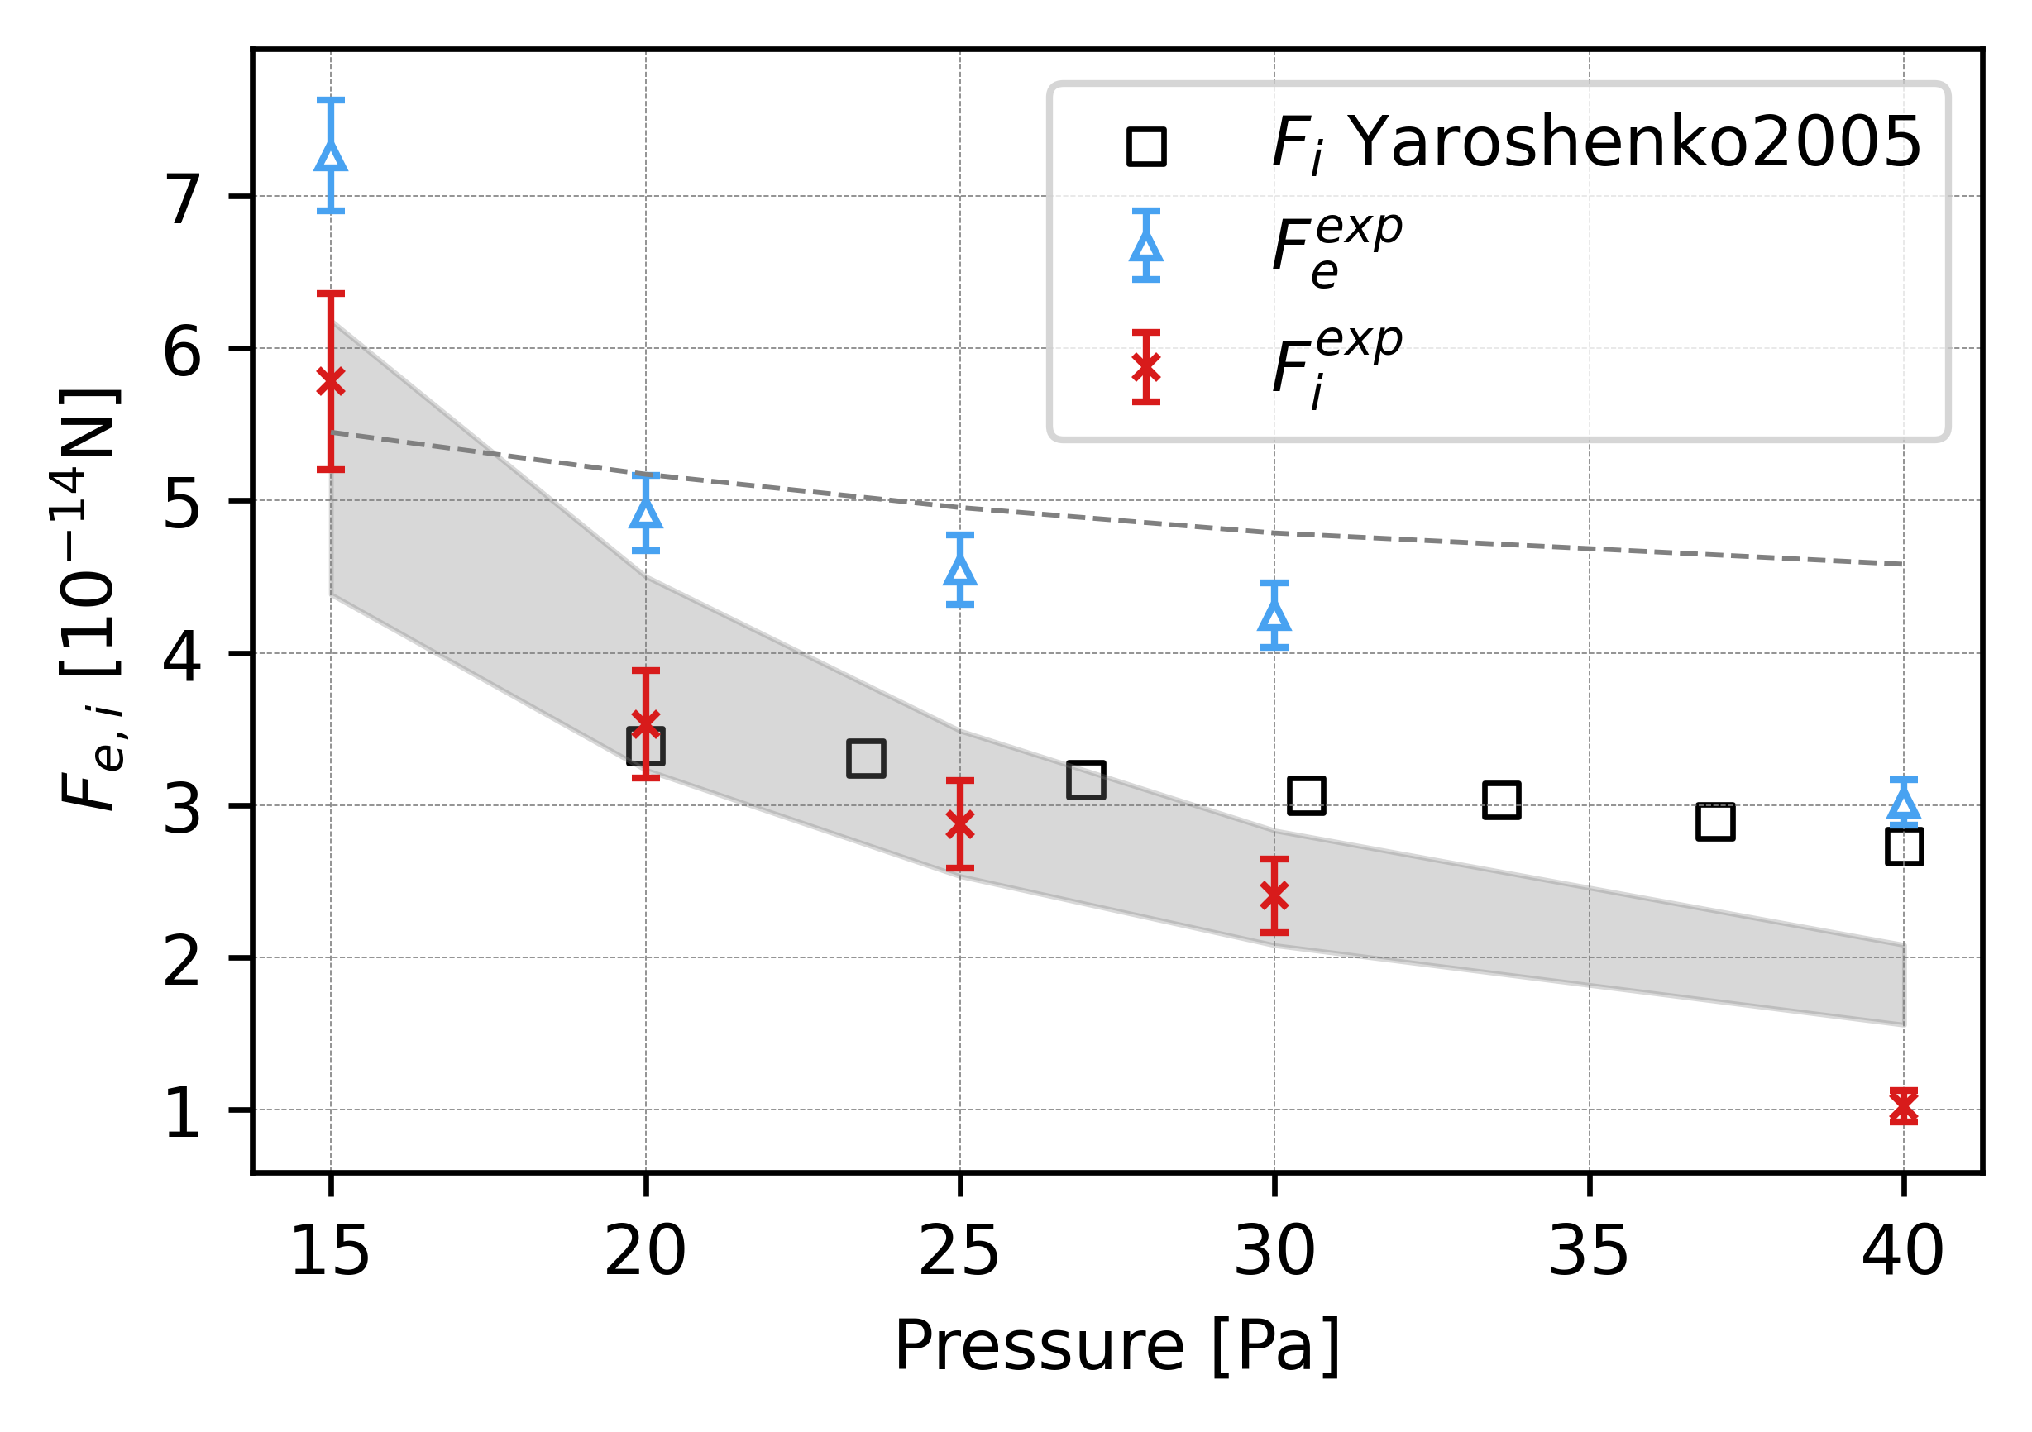

Slide 18
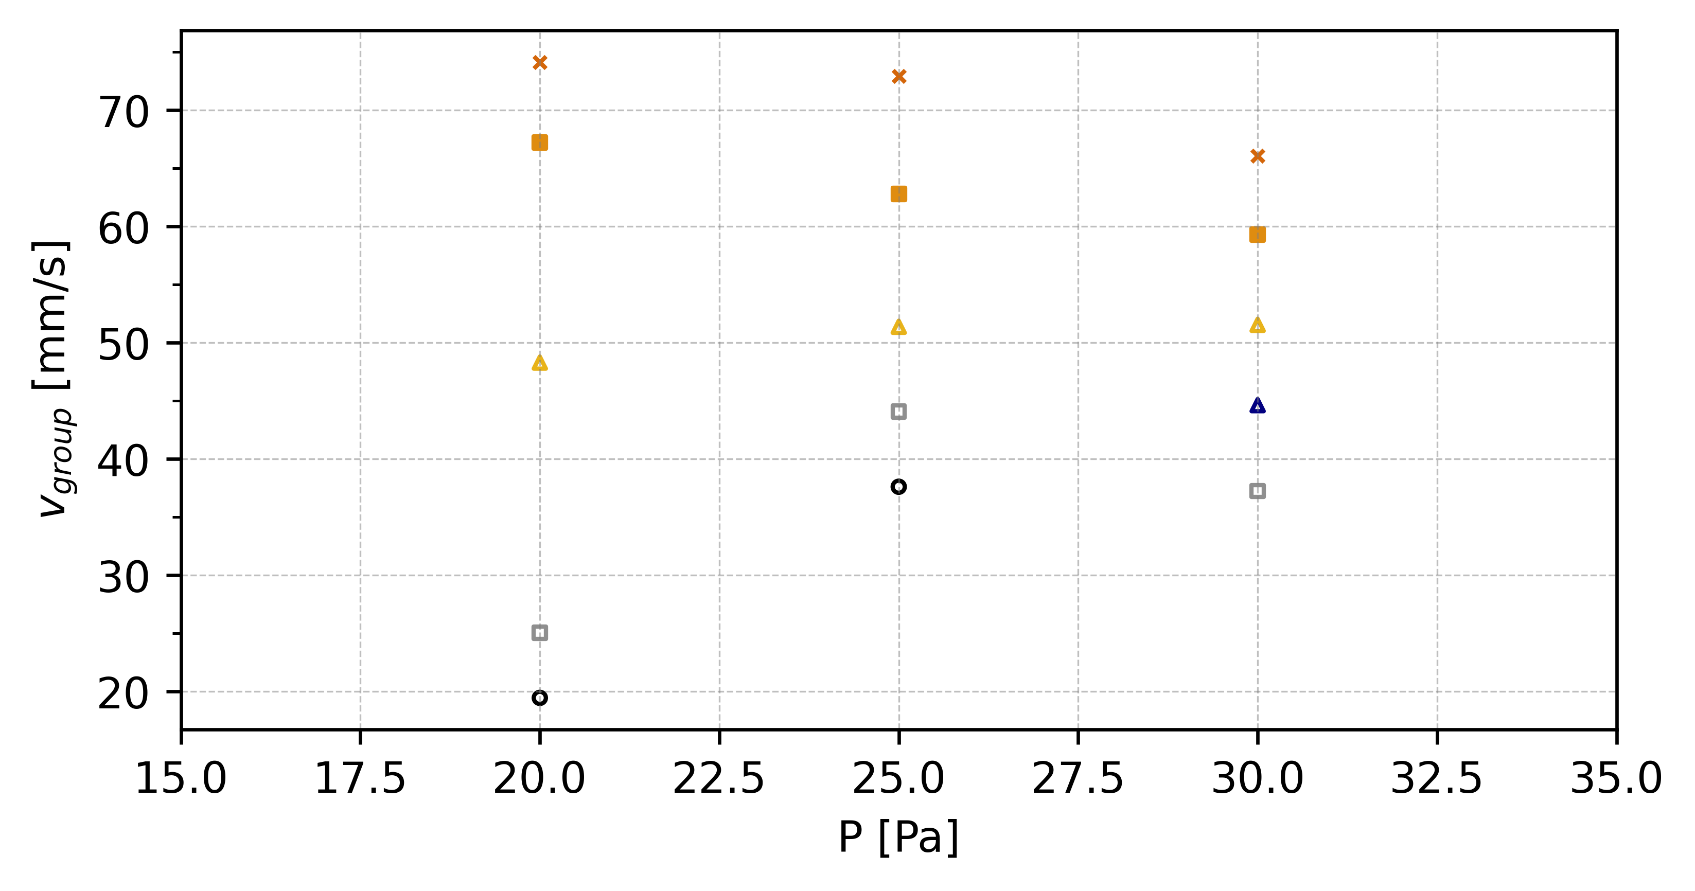
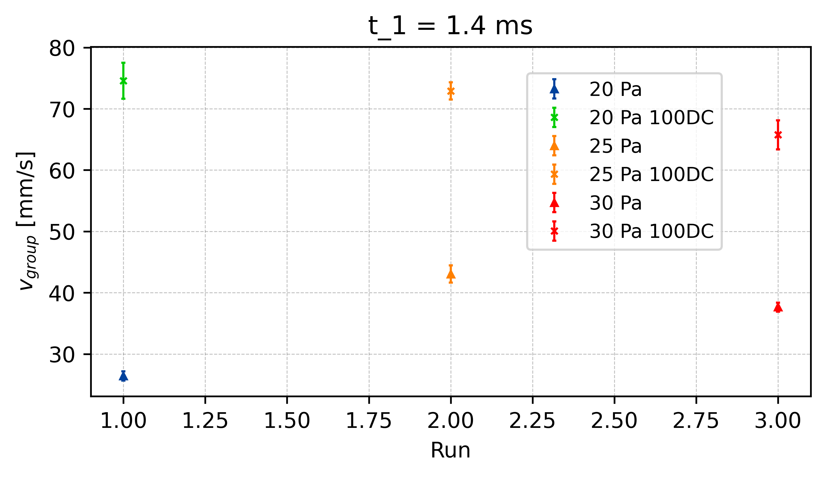
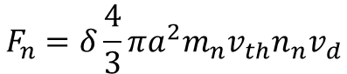
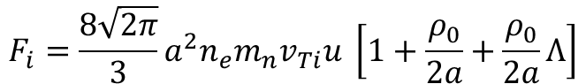
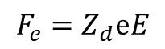
Reduction of Electric Field - v_{group}
t = 1.3ms
E_{effectiv} = 30%
100%
t = 1.4ms
E_{effectiv} = 40%
t1.4
80%
t = 1.5ms
E_{effectiv} = 50%
60%
t1.4
∆v_{25_t1.4}
t1.4
50%
∆v_{20_t1.4}
∆v_{30_t1.4}
$$F_{e}=Z_{d}ⅇE$$
40%
x E_eff
30%
$$F_{n}=δ\frac{4}{3}πa^{2}m_{n}v_{th}n_{n}v_{d}$$
$$F_{i}=\frac{8\sqrt{2π}}{3}a^{2}n_{e}m_{n}v_{Ti}u \left[1+\frac{ρ_{0}}{2a}+\frac{ρ_{0}}{2a}Λ\right]$$
x E_eff
x E_eff
Vergleiche: V_g vs P und V_g vs E

Slide 19
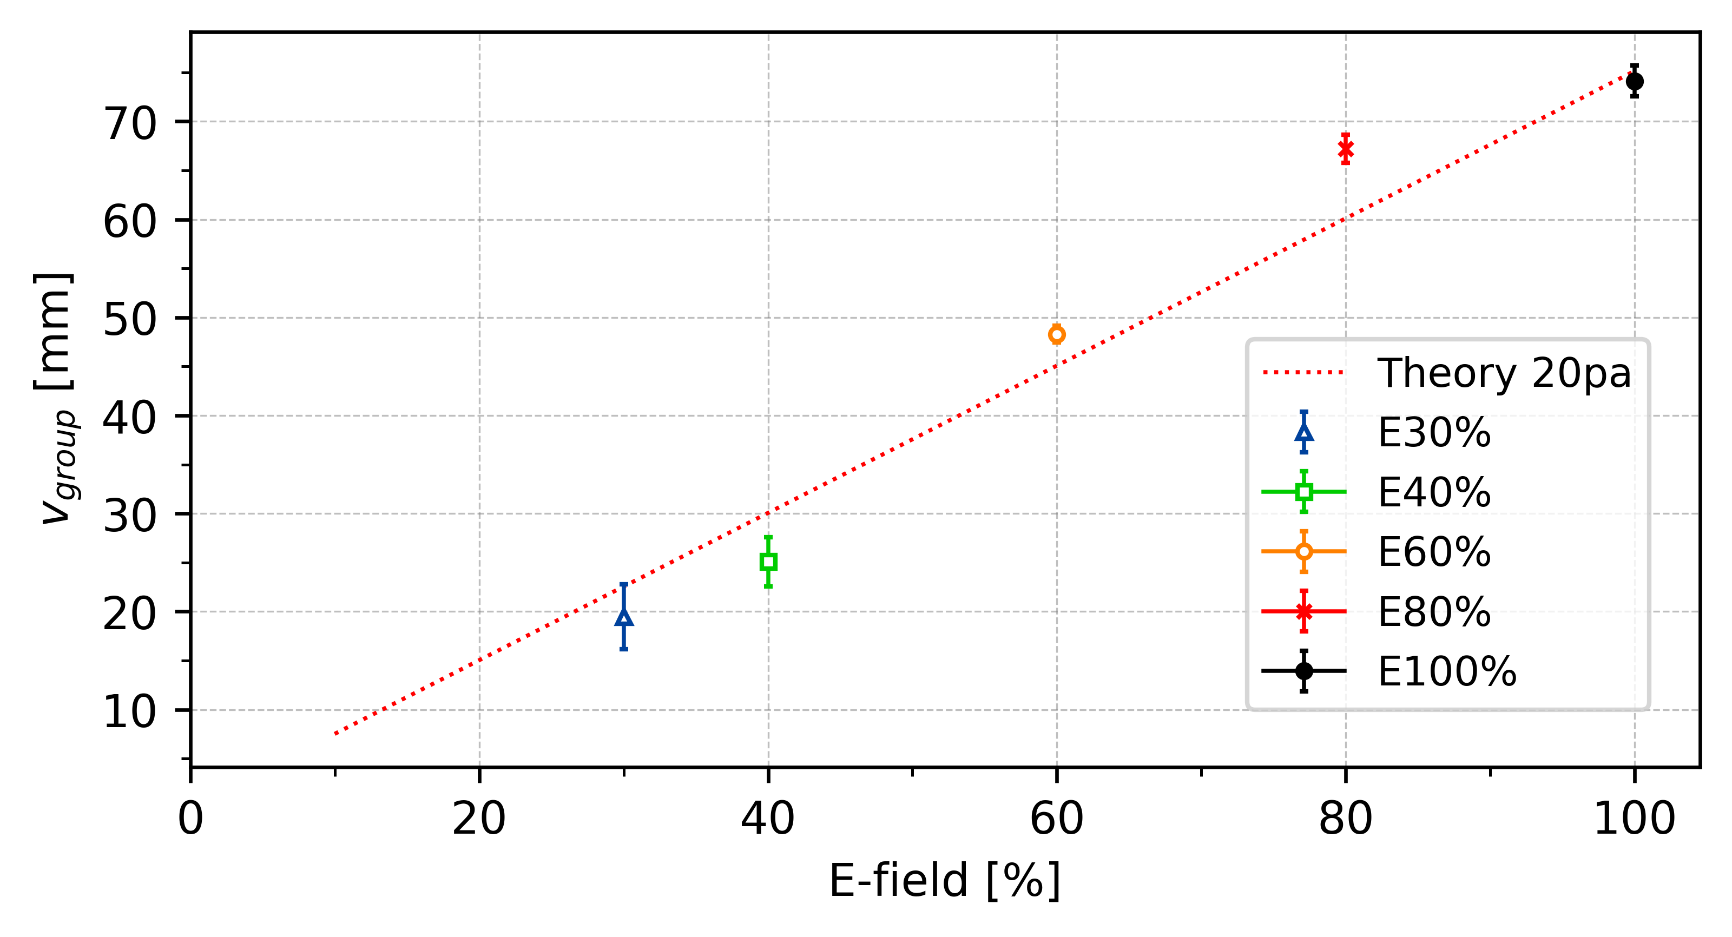
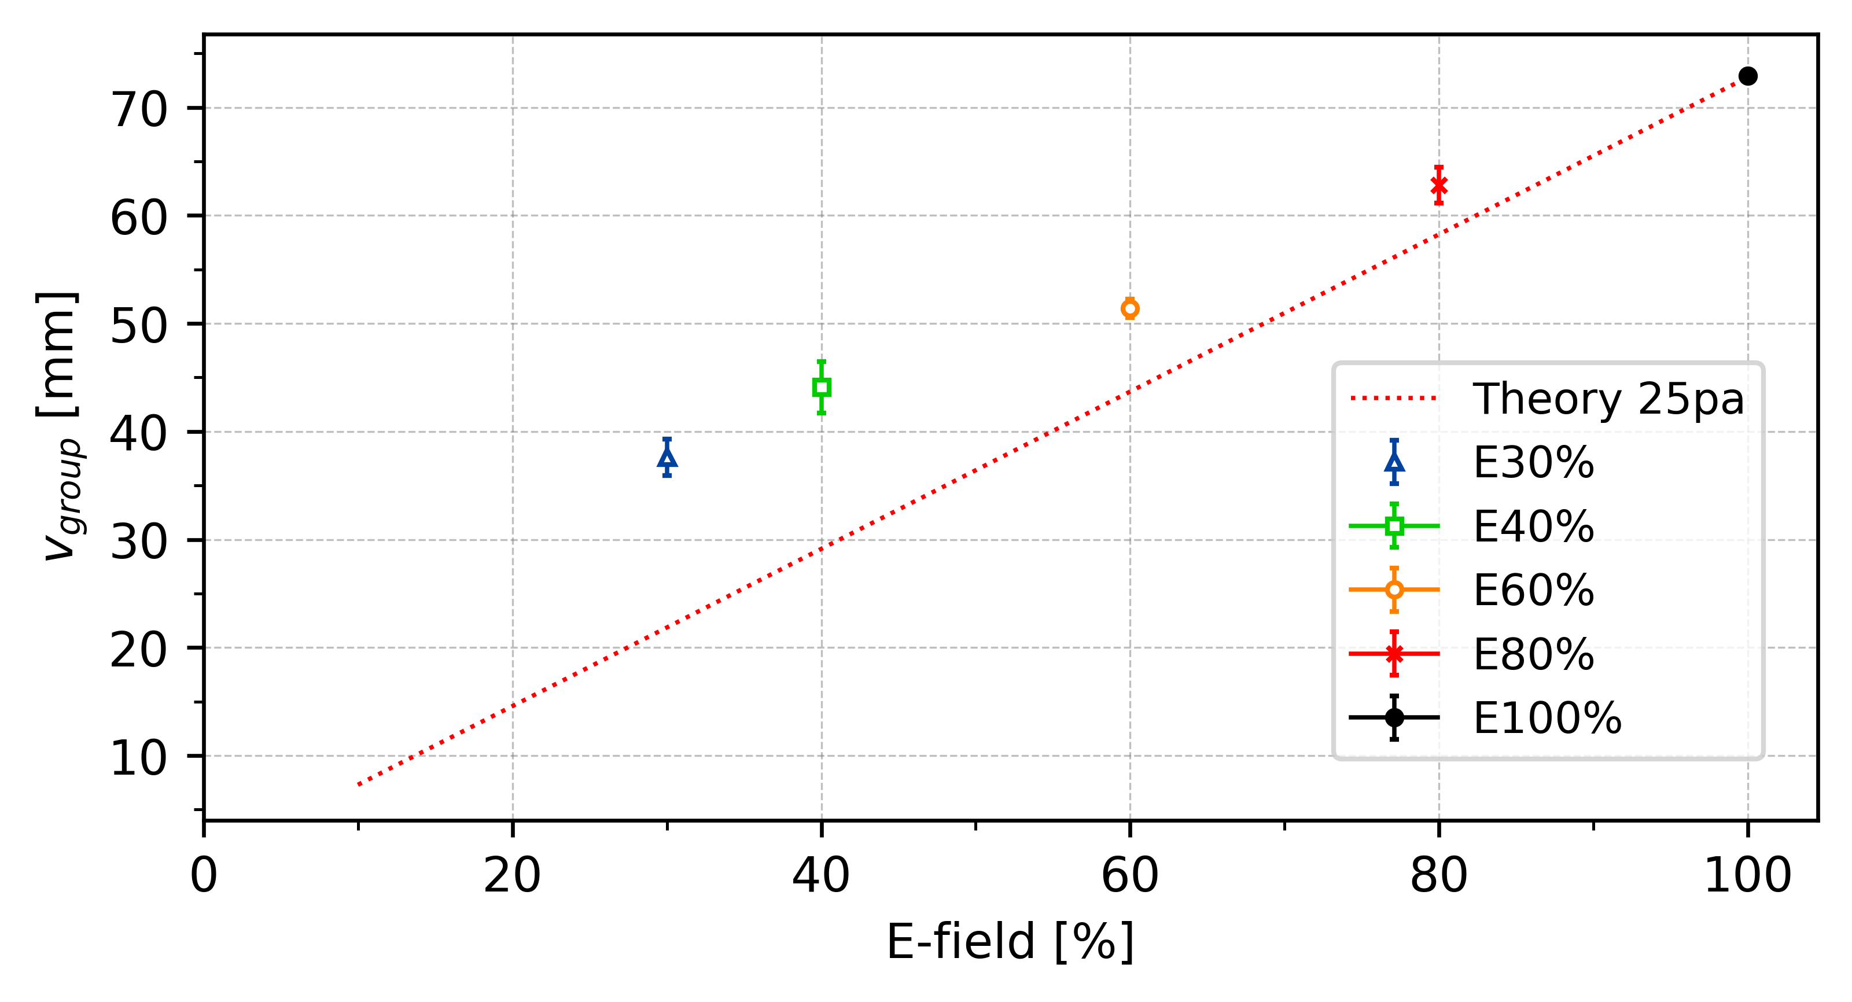
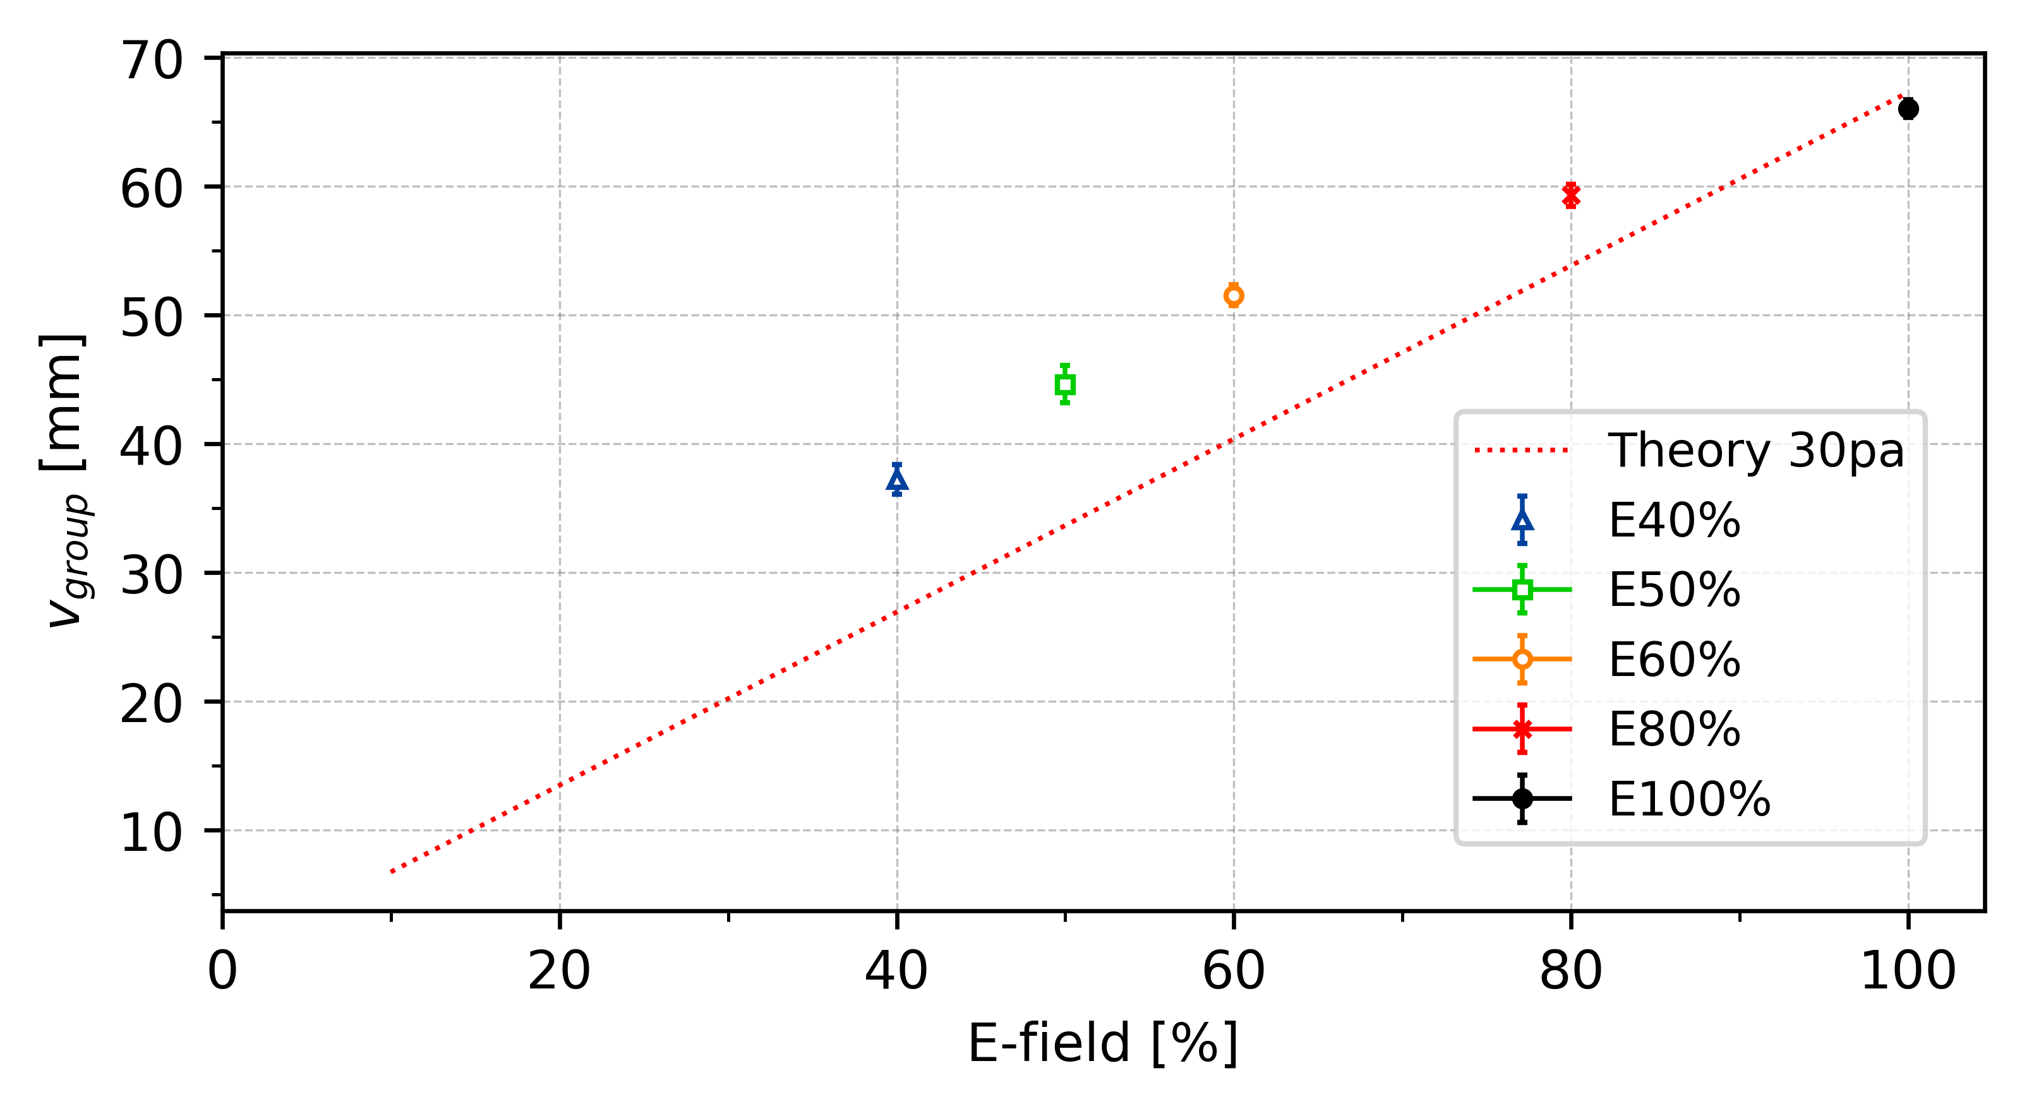
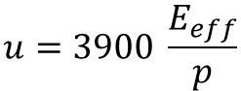
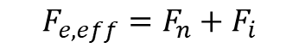


Reduction of Electric Field - v_{group}
. . .
t = 1.3ms
E_{eff} = 30%
$$F_{e,eff}=F_{n}+F_{i}$$
t = 1.4ms
E_{eff} = 40%
$$F_{e,eff}=Z_{d}ⅇE_{eff}$$
t = 1.5ms
E_{eff} = 50%
. . .
$$F_{i}=\frac{8\sqrt{2π}}{3}a^{2}n_{e}m_{n}v_{Ti}u \left[1+\frac{ρ_{0}}{2a}+\frac{ρ_{0}}{2a}Λ\right]$$
$$u=3900 \frac{E_{eff}}{p}$$
Modified frost formular?

Slide 20




Slide 21


Reduction of Electric Field - C_{DAW}
t = 1.4ms
E_{effectiv} = 40%

Slide 22



Reduction of Electric Field - C_{DAW}
*E_eff[%]
Or ?
*E_eff[%]

Slide 23




Slide 24



Slide 25



Slide 26



Slide 27



Slide 28

Critical Electric Field - C_{DAW}
Pressure | C_Forward | E-field Forward | E-crit
20
20
25
25
30
30

Slide 29
Appendix

Slide 30


Polarity Difference
Average
∆c_20 = 11.0 mm/s ~ 14.5%
∆c_25 = 13.5 mm/s ~ 17.8%
∆c_30 = 7.8 mm/s ~ 11.9%
∆c_20
∆c_25
∆c_30

Slide 31


∆c_30 = 8.5 mm/s ~ 17.0%

Slide 32




Slide 33


-
∆c_25
∆c_30
∆c_20 = 4.5 mm/s ~ 14.5%
∆c_25 = 7.5 mm/s ~ 15.5%
∆c_30 = 6.9 mm/s ~ 15.5%
∆c_20

Slide 34

331 = 3,9058 mm
10 f = 0,16 sec
24,3 mm/s

